Slide 1

NewCo CPQ Masterdoc

Slide 2

Newco high level view

Slide 3
First of all, the aim is to provide a NextGen IT stack to support
NextGen Products, NextGen Customer Journeys, and operating models, enhancing a digital-first Customer Experience.

Slide 4




We are in the Horizon 0 phase to set-up the NewCo program and build the foundations for future success
Phasing
Horizon 0
Horizon 1
Horizon 2
Horizon 3
Mobilization & Design
Build the Foundations
Expand Capabilities
Unlock Value of Change
Program delivery model setup
Greenfield customer journeys and processes designed
SI Partner and Solution vendors selected and onboarded
NewCo execution launched
First transformation programs and some partial greenfield products
Launch of prioritized product offerings
First set of customers onboarded
Foundational business capabilities deployed
Business capabilities and NewCo product portfolio expanded
Customer scaling
Progressive redesign of existing offerings to launch on new stack
Customer enablement and migration on new offers
The re-platforming of billing
We are Here

Slide 5






Crafting a seamless customer experience by incorporating modularity will ensure reusability and a consistent customer journey across products & channels
Modularity breaks down the customer journey into distinct, interchangeable components or modules, each representing specific customer actions, processes, and interactions.
Digital First
CX ambition
Cost optimization
The Service Implementation Expert (SIE) assembles modules to make up the product and guarantees the efficiency of the end-to-end customer journey.
--- Customer Journey Modules ---
Customer journey
The Customer Journey Business Owner (CJ BO) guarantees the vision of a portion of the customer journey
Process 1
Process 1
Process 1
  The Module Owner (MO)
  develops and upgrades modules and guarantees their integrability in products
Caracteristics
Caracteristics
Caracteristics
Teams
Teams
Teams
Tools Data
Tools Data
Tools Data
IT component
IT component
IT component
Notes:
Customer Journey Excellence

Slide 6
NewCo streamlines the Customer Journey from Lead to Bill
NextGen Products
Communication Services, Smart Mobility, Digital Services, OCD
Transforming towards
NextGen Customer Journey
I observe
Supported by
NextGen operational model
Lead to Order
Order to Bill
Enabled by
NextGen
IT capabilities
CRM 2.0
E-commerce
EPC, CPQ
CLM
COM, SOM, ROM

Slide 7
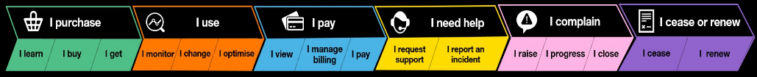
Customer Journey Business Owners Orange Newco Program
Digital exposure
Florence MACRESY
Mathilde LEPAGE
Customer Journey Leads
Maxime
LE LOUARN
Franck CARMINE
Sophie
LAMIRAUX
Matthieu GRIMONPONT
Sophie
LAMIRAUX
Maxime
LE LOUARN
Customer Journey Managers
I
observe
I
change
I
optimise
Xavier
LE DEMEET
Saurabh M
Capgemini
Infosys
Praveen S
Lot 1
Lot 2
Lot 3
Lot 4
Ahmed
AIT RAIS*
Snehil
The design, build, test and run of the Digital Portal and API Layer capabilities
The design, build, test and run of the BSS and Fulfillment OSS capabilities
The design, build, test and run of the Service Management and OSS Assurance capabilities
The end-to-end test and site reliability engineering for the Newco program
Niharika
CJ-BO
CJ-EO
New Orange CJ-EO
Chaya, Preetinder, Jahnavi, Emilien
*external

Slide 8




How we structure the backlog for IT assets using the artefacts we have been developing and refining within NewCo Customer Journey
Create a detailed and modular use case library encompassing both customer and OB use cases to ensure complete scope coverage and allow us to identify the processes we need to consider.
NewCo Backlog
1
Enterprise Epics
Transformation program or Greenfield product
Epics
Modules : Customer use case & Business Processes L2
Use Case Library
L1 Process
L2 Processes
Features
Use cases L3 (Customer & OB)
L3 Processes
Process Library
L4 Processes
User stories
Detailed functionnalities linked to L4 processes
2
Develop a comprehensive Process Library and map the use cases from the Use Case Library to the L1-L3 processes. 1 use case must be covered by at least 1 process.
Use the L2-L4 processes as documented in the Process Library to build out the NewCo backlog from Epic to User story level.
3
Notes:
Every use case must be covered by 1 or more processes
Can use big picture to indicate the link between the use case library and the underpinning processes
What is the rule for L3 to L4 – confirm this
- Include examples

Slide 9
The foundations upon which NewCo is built
Next Gen Customer Journey
Next Gen
Products
Next Gen IT
Modularity
Reusable modules to re-create custom product solutions in a unified customer journey and merging Customer, Site, Contact, Supplier refs. for a single source of truth
Digital 1st
Autonomous online end-to-end management of services through improved digital interfaces
Scopeless
Seamless single funnel and pricing scheme to manage services regardless of business lines, regions, etc.
Product-agnostic
Seamless single funnel and pricing scheme to manage services regardless of products.
Platformation
Designing and operating products as standard services (hyperscaler model)
AI & Automation
Client facing and operational processes optimized through automation and integrated with AI
COTS
Leveraging existing best-in-class market solutions for systems
Unified Architecture
Rationalization to form an enterprise-wide systems architecture
Notes:
COTS = Commercial off-the-shelf
Digital first:

Slide 10






Integration layer - IPaaS (RFP)
NewCo’s part in the IT architecture transformation
Customer Oriented
Orange Business marketing sites: eCare (Vibe), eShop (WIP) … etc
SoHo-SME Web space & shop
Identity and Access Management
(OneAdmin)
CRM (Salesforce 2.0) (presales, sales)
API GW - IPaaS (RFP)
CRM (Safary)
CLM (contract management)
Request/Service mgt (Nacre)
Service Management (ServiceNow 2.0) (incidents and changes)
Sales Oriented
Observability and
Monitoring (RFP)
(of solutions deployed for customers)
Billing Oriented
New Offers
Current Offers
New Offers
Current Offers
EPC
(catalogue)
EPC
(Castor E, Inca, GRP, Fed Cat)
Invoicing
(IMS)
Invoicing
(IMS, Fusion OBS)
CPQ
(config, pricing, quoting)
CPQ
(Abacus, Enov, IS Quote, Quoto)
Tech Oriented
Billing
(IMS, Safir)
Billing
(IMS, Safir, Fusion OBS)
COM + Assets
(order, installed base)
COM + Assets
(Indigo, Satin, Gold, CIBase)
SOM & ROM (RFP)
(delivery management)
Rating
(Safran)
Rating
(Safran, Fusion OBS)
SOM
(Oper@, Salto FR & Int)
360 Inventory (WIP)
Data layer
Transversal Referential
Enterprise IT
Site (SiteRef)
Organization (new RCE)
OrangeFacingRoles (FARO)
Contacts (RICE)
EDH
Bleu
Data Mesh
Customer & Billing Account
(CompanyRef)
IT core and connectivity
Procurement
Finance
(Fusion OBS, Alcyone)
HR
Notes:
Currentco complete scope for CPQ: Abacus, Enov, IS Quote, Quoto replace by CSG from an applicative perspective

Slide 11
NewCo ecosystem – High-level interactions
Foundation Customer Journey
CJF define quality standards/basic requirements for module lists
CJ EPICS
Provide inputs to describe the product process
Product Mutli-disciplinary team
Product EPICS
Business Owner
CTIO
Provide list of CJ modules
Communicate update processes
Product Marketing Manager
Responsible of the definition and construction of modules
Define basic of CJ modules
Module Governance
Product Epic Owner
Product Modelling
Receive the list of modules
Create a Library aggregating all Modules/OPC
Monitor the quality of the list
Provide product definition
Monitoring
Product Design requirements
Provide Guidelines and orchestrate
Validate the level of quality of the module
SIE(s)
Report their work to
Description of the E2E process of a product
Assembles standard modules
Identifies and describes product specificities (catalog driven)
Feedbacks for refinement
Epic Owner(s)
Build consistent Modules (product agnostic)
Check the consistency of processes across all products (to avoid redundancy)
Provide product development standards
Report their work to
Provide CJ Modules amended with product specificities
  C2R
Promote modularity / standardization, support SIE
Ensure consistency into Product Lifecyle Management
Feedback loop and progressive enhancement of CJ EPICS interactions to clarify how to deploy new product(s)
Notes:
"pour aller plus loin"
Construct multi disciplinary team → product EPIC is part of that (CTIO, MTKG, …)
SIE represent CJ within rhe product Epic → work with CJ EpICS to clarify requirements

Slide 12
Overall Newco Flow-Lead to Bill

Slide 13
Overall NewCo Flow – Lead to Quote, Quote to Order, Order to Bill
Complex Project Flow
Lead
Opportunity
Project Quote
Contract (MSA)
Project
Firm Quote & Order Forms
Commercial Order
Technical Order (Service/Resource)
Inventory Instantiation and Initial Bill
What
Establishing a lead and initial information provided to identify the customer.
Perform prequalification step
Onboarding Customer to enable opportunity, quotation, contracting and ordering
Establishing an opportunity
Information provided to onboard the customer
Perform qualification steps.
What
Project quote forms the basis of outlining the sites, the services, their configuration and pricing. Eligibility is validated, P&L calculated and approvals sought both internally and externally.
The project quote helps to frame the MSA considering the services, the pricing and other conditions e.g. SLAs, as well as broader contractual terms.
If the contract is accepted the project for delivery is initiated. Projects may be running from the inception of the RFP through it's response, but here the project frames the phasing and the sites that will be delivered according to scheduling agreed between the client and the project manager.
Firm quotes are raised for the deliveries, and service contracts need to be signed by the customer to convert the firm quote into an order. For projects multiple firm quotes need to be raised reflecting segments of the project quote and an aggregate of service contracts should be signed for
Further onboarding of contacts, site information and billing details can occur here to facilitate the order.
What
Creation of the commercial order, with decomposition and orchestration leading to the creation of service orders and resource orders.
The conclusion of the order results in the instantiation of the commercial and technical inventories and the triggering of billing.
Quote
Order Form and Standard T&Cs
What
For simple cases e.g. single service, single site, the customer can raise a quote through self serve or through an OB Sales Agent.
The generation of a standard contract can be automated leveraging the standard pricing.
Prospect or Customer
Customer
What
These stages of the process will be engaged by both existing customers and prospective customers.
Key differences in steps revolve around customer onboardings, and where existing contracts may apply, delivering amendments to such contracts to cover services provisioned outside of original terms.
What
From this point on, once the contract is signed, we are dealing with an existing customer now.
Notes:
NewCo Customer Journey Steel Thread.pptx

Slide 14
Lead
Opportunity
Lead Generation
Lead Qualification
Lead Activation
Lead Performance / Reporting
Opportunity Creation / Categorisation
Opportunity Qualification
Proposal and Negotiation
What
Acquire leads from various sources.
Minimum information required to identify a contact person.
Auto-lead capture upon interaction with OB including catalogue browsing and quote config, bulk lead upload via file, manual lead creation.
Generic vs Product Specific
Process is generic
What
Verify and categorise leads based of relevance, existing customer status, alignment to target profiles.
Routing to marketing team to qualify upon creation of contact.
Enrichment of lead information to support qualification/targeting.
Lead assignment to sales representatives, based on geography, industry, product interests.
Generic vs Product Specific
Process is generic, but referencing high-level product offers in catalogue.
What
Standardised assignment of score to lead based on engagement level with marketing, fit with OB products and solutions, intent and interest. MQL (Marketing Qualified Lead)
Lead Nurturing and Sales Qualification. MQL > SRL (Sales Ready Lead)
Handover of lead from marketing to sales prior to opportunity creation.
Generic vs Product Specific
Process is generic
What
History, tracking and reporting on lead.
Monitor lead processing times, transformation of leads to opps, sales coverage.
Link to marketing campaigns and status changes.
Generic vs Product Specific
Process is generic, but referencing high-level product offers in catalogue.
What
Opportunity assignment to appropriate manager.
Automated lifecycle management, e.g. digital orders generating opportunity, updates to status based on wins, informing users of status changes.
Unified management and sales qualification according to OB value proposition.
Generic vs Product Specific
Process is generic, but referencing high-level product offers in catalogue.
What
Solution scoping, alignment to customer needs and effective categorisations for sales processes.
Partner engagement on technical and commercial activities.
Go/no-go gates with deal approval committee submission for opp type and approval criteria.
Generic vs Product Specific
Process is generic, but referencing high-level product offers in catalogue.
What
Bid team formation, resource engagement for opp and products, and PM onboarding
Solution design and proposal development, including quote and contract generation.
Bid submission to deal approval committee, and proposal submission to customer.
Negotiation with the customer to close the deal and sign the contract – interaction with quotation and contracting processes.
Generic vs Product Specific
Process is generic, but referencing catalogue for solution design.
Opportunity
Customer Referential
Opportunity Closure
Opportunity Performance / Reporting
Sales Cadences
Account Onboarding
Contact Onboarding
Site Onboarding
Billing Details
What
Handover of all information to operational teams to allow implementation, running and billing of solution.
Closure of won and lost opportunities, with archival of CRM information in the future.
Generic vs Product Specific
Process is generic
What
Win/loss review process.
Managing and monitoring opportunity response times.
Feedback process into improving products and sales.
Pipeline management
Generic vs Product Specific
Process is generic
What
Next best actions – recommending next steps for sales reps.
Guided selling on types of products available and recommended products.
Capture of customer interactions and activities.
Generic vs Product Specific
Process is generic
What
Creation of account allowing for opportunity, quote and order creation.
Credit management of customer
Ability to clean up customer records where RFP bids are lost.
Generic vs Product Specific
Process is generic
What
Creation and validation of contact.
Allocation of different rights and permissions on processes.
Contact can have one or more profile, and be allocated to one or more organisation/customer
Customer admin to create/update contacts.
Generic vs Product Specific
Process is generic
What
Creation of site including ability to establish exact address down to lowest level.
Management of site hierarchy, e.g. one site with two sub-addresses
Site role establishment e.g. delivery vs install.
Customer admin to create/update sites.
Generic vs Product Specific
Process is generic
What
Management of BAN to determine how billing should take place.
Generic vs Product Specific
Process is generic
Notes:
NewCo Customer Journey Steel Thread.pptx

Slide 15
Quoting
Quote Offer Creation
Quote Offer Pricing (and Configuration)
Quote Offer Eligibility
Quote Offer Profitability
Quote Offer Customer Approval
Exception Management
Quote Order Creation
What
Quote creation for projects, or firm quote creation for mono-site when site is ready for launch.
Management of multiple quote iterations (primarily for a single bid).
Catalogue browsing, search and selection of relevant products
Generic vs Product Specific
Process is generic, draws from catalogue to search and select product offers.
What
Configuration, pricing and discounting of product offers driven by the product catalogue.
Querying the install base/inventory to allow validation of existing services, verify compatibility, and allocate resources requested.
Query of 3rd party pricing.
Generic vs Product Specific
Process is catalogue driven down to product component selection, and configuration.
What
Commercial and technical eligibility checks.
Operational and date availability eligibility checks.
Legal and contract eligibility checks are performed.
Generic vs Product Specific
Process is generic, but catalogue of eligibility checks are invoked depending on the product configuration.
What
P&L process assessing cost vs price, margin, and applying standardised internal approval process based upon gross margin.
Generic vs Product Specific
Process is generic
What
Submission of quote to the customer for review and acceptance.
Generic vs Product Specific
Process is generic
What
Quoting for exception use cases where product is not in the catalogue.
How OB can quickly quote for such services to meet bid response in time, and what information is gathered to support it.
Generic vs Product Specific
Process is generic
What
Creation of the firm quote (particularly where project leads to the creation of multiple quotes which will be converted into orders.
Customer approval for ordering (tied into service contract signature).
Generic vs Product Specific
Process is generic, but catalogue driven.
Contracting
Contract Generation
Contract Negotiation
Contract Agreement
Contract Lifecycle Management
What
Creation of a standard contract based on the products and services being quoted for, and the type of customer.
Attachment of relevant appendices to the contract.
Generic vs Product Specific
Process is generic, but driven by product component selection and configuration within the quote.
What
Customer requesting changes to the contract and the T&Cs.
Internal approval process for analysing and approving customer change requests.
Generic vs Product Specific
Process is generic.
What
Internal approval processes for submitting a contract to the customer for signature.
Customer approval process, including the customer signing and returning the contract, and OB also signing the contract.
Generic vs Product Specific
Process is generic.
What
Storage of the contract in the CLM tooling.
Ability to browse and review the contracts held against a customer’s account.
Data management to allow validation of terms e.g. when there are inflight order changes.
Obligations and risk management.
Validation of renewal and cease terms.
Generic vs Product Specific
Process is generic
Notes:
NewCo Customer Journey Steel Thread.pptx

Slide 16
I LEARN
I BUY
1. User Journey - Digital order of a standard product of the catalog
I become aware
I review the options
I research pricing / timeline / plan
I provide requested information
I request a proposal
I evaluate my options
I access self-service
I receive my pricing
I provide requested information
I negotiate and sign a contract
I place my order
I validate my order
Advertisement & Promotion
Customer Onboarding
(site info)
Accessing OB Offerings
Qualification and Screening
Browsing the Contract
Options 1 & 3
Customer Onboarding
(billing + info)
Contracting
(Order form Contract & sign)
Convert Quote to Order
Customer use cases
Option 3
prospect sign-up
Assess my needs
Browsing the Catalogue
Customer Onboarding
Account creation
Quote Design
( Customer learns & Firm Quote)
Customer Onboarding
( account creation)
Option 2
Browsing the marketing material
Option 1
customer sign-in
Option 2
prospect no sign-up
Eligibility
(commercial & technical)
Qualification and Screening
Com. & Mark., Automated
Automated
Marketing Tool
Portal
CPQ
E2E Catalogue
Referential, CRM
CPQ
Referential, CRM
CLM, CRM
Campaign Management
Catalogue Management
Customer Referential
Customer Quotation Process
Customer Referential
Customer Contracting
Customer Quotation Process
Campaign Planning
Product Catalogue Browsing
Customer Account Onboarding and Lifecycle Mgmt.
Quote Offer Creation
Contract Generation
Customer Billing Onboarding and Lifecycle Mgmt.
Contract Negotiation
Quote Order Capture
Audience Management
Customer Contact Onboarding and Lifecycle Mgmt.
Quote Offer Pricing
Contract Agreement
Options 1 & 3 only
Quote Offer Eligibility
Customer Contract Lifecycle Management
Business Processes L1 & L2
Content Creation & Management
Quote Offer Profitability
Opportunity Management
Interactions are recorded all along the journey
Option 3 only
Lead Management
Quote Offer Customer Approval
Opportunity Management
Campaign Execution
Opportunity Creation & Categorization
Customer Referential
Opportunity Performance and Reporting
Handover
Campaign Performance & Reporting
Lead Generation
Opportunity Performance and Reporting
Account Management
Partner Campaigns
Lead Qualification
Customer Site Onboarding and Lifecycle Mgmt.
Sales Cadences
Lead Activation
Lead Perf., Historization and Reporting
Customer Interactions
Digital Request Management
Notes:
NewCo Customer Journey Steel Thread.pptx

Slide 17
2. User Journey - Manual order through a sales rep
I LEARN
I BUY
I become aware
I review the options
I research pricing / timeline / plan
I engage s Sales specialist
I evaluate my options
I receive my pricing
I provide requested information
I negotiate and sign a contract
I place my order
I validate my order
Advertisement & Promotion
Customer Onboarding
(site info)
Eligibility
(commercial & technical)
Accessing OB Offerings
Interaction with Sales
Browsing the Contract
Quote Design
(Quote Update)
Customer Onboarding (billing + info)
Contracting
(Order form Contract)
Convert Quote to Order
Customer use cases
Assess my needs
Browsing the Catalogue
Customer Onboarding
(account creation)
Quote Design
Negotiation
(price)
Negotiation
(contract)
prospect no sign-up
Browsing the marketing material
Qualification and Screening
Eligibility
(commercial & technical)
Com. & Mark., Automated
Sales, Sales Enablement, Legal & Finance
Automated
Sales, Sales Enablement
Automated
Marketing Tool, Portal
Portal
CRM
CPQ
Portal
CPQ
E2E Catalogue
Referential
CRM
CPQ
Referential, CRM
CLM, CRM
Campaign Management
Catalogue Management
Customer Referential
Customer Quotation Process
Customer Referential
Customer Contracting
Customer Quotation Process
Campaign Planning
Product Catalogue Browsing
Customer Account Onboarding and Lifecycle Mgmt.
Quote Offer Creation
Customer Billing Onboarding and Lifecycle Mgmt.
Contract Generation
Quote Order Capture
All along the I BUY journey
Audience Management
Customer Contact Onboarding and Lifecycle Mgmt.
Quote Offer Pricing
Contract Negotiation
Opportunity Management
Business Processes L1 & L2
Quote Offer Eligibility
Contract Agreement
Content Creation & Management
Customer Site Onboarding and Lifecycle Mgmt.
Quote Offer Profitability
Customer Contract Lifecycle Management
Quote Offer Customer Approval
Sales Cadences
Campaign Execution
Opportunity Performance and Reporting
Campaign Performance & Reporting
Lead Management
Opportunity Management
Opportunity Management
Client Interactions are recorded all along the journey
Account Management
Partner Campaigns
Lead Generation
Opportunity Creation & Categorization
Negotiation
Lead Qualification
Qualification
Handover
Lead Activation
Customer Interactions
Lead Perf., Historization and Reporting
Notes:
NewCo Customer Journey Steel Thread.pptx

Slide 18
Newco Architecture for MVP (including applications)

Slide 19
End to End Architecture
Digital Experience
OBS.com
Customer Portal
Developer Portal
Marketplace
Agent Support
Contact Center
Shared Services
API Gateway
Identity
Dev Ops
Integration Layer
Data Management
Referential
CRM
EPC
Consumed by all systems needing Product definition in catalogue driven architecture)
Customer / Organisation
Service Management
Site
CLM
Contract
CPQ
SNOW
Billing Account
Billing
CMDB
Suppliers, Carrier and Vendor Mgmt
COM
Mediation
Number Management
Commercial Inventory
P&L
financial performance tool
SOM/ROM
EDH / Data Lake
Service Assurance
Supplier PO
Observability
Service Inventory
Resource Inventory
Supplier Mgmt & Interface
Common Systems
Diagnostics
Notification
Task mgmt.
License Mgmt
Correlation
Service eligibility, availability & qualification
Service Activation & Testing
Network Domain Controllers
Appointment Mgmt.
Proj Mgmt.
Monitoring
Reuse of existing Systems
Network/Infrastructure

Slide 20
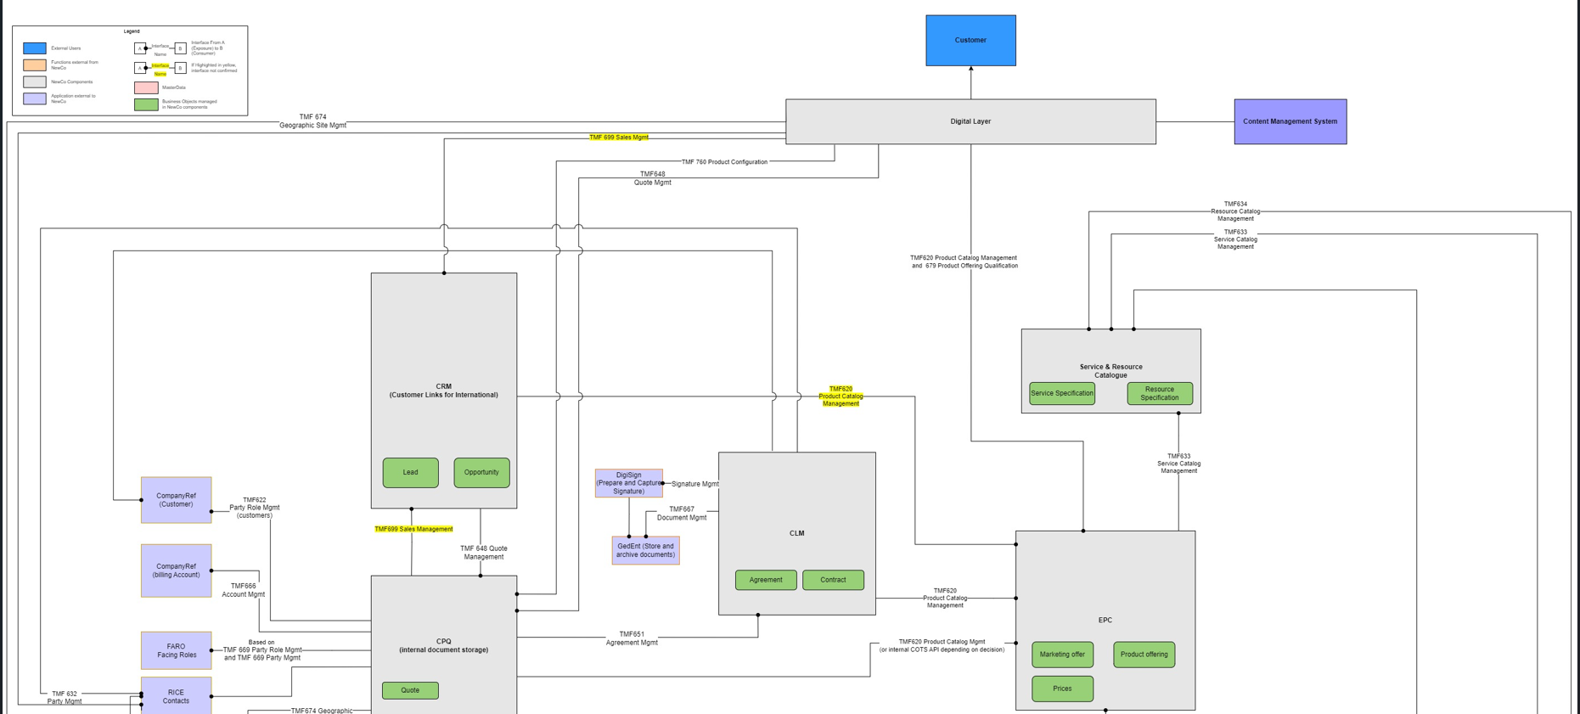
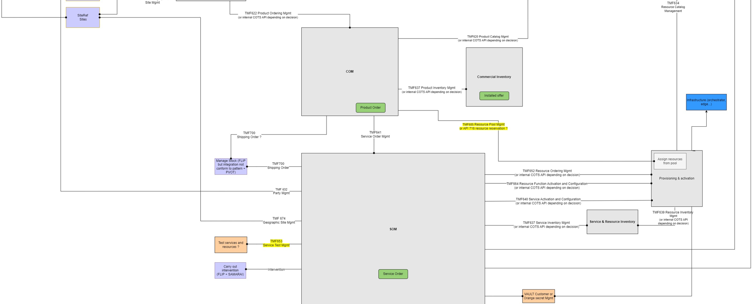

Slide 21
CPQ E2E process flow

Slide 22

DRAFT
Does the customer open his cart after log in back again ?
CPQ- E2E process flow (MVP)
OB-serve & Self Servedraft)
L3 – Cart saved for later
L3 – Price and quote expiry
L3 – Cart saved for later
L3 – Price and quote expiry
X
NO
YES
L3 – Retrieve Quotes (Self-serve)
L3 – Retrieve Quotes (Self-serve)
Non site-based
NO
L2 - Quote Offer Creation
L2 - Quote Offer Creation
L2 - Quote Offer Creation
L2 - Quote Offer Creation
L2 - Quote Offer Pricing
L2 - Quote Offer Customer approval
L2 - Quote Offer Customer approval
L2 - Quote Offer Customer approval
L2 - Quote order Capture
Updates required ?
Quote approved by customer ?
L3 - Quote Offer Initialization
L3 - Add site to quote
L3 – Retrieve eligible Product
L3 – Add Product to quote
L3 – Configure Product & view Pricing
L3 – Quote Document generate
L3 - Quote Offer submission to Customer
L3 – Capture customer approval of quote
L3 - Quote Offer Initialization
X
Site-based
L3 - Add site to quote
X
L3 – Retrieve eligible Product
L3 – Add Product to quote
L3 – Configure Product & view Pricing
X
X
L3 – Quote Document generate
L3 - Quote Offer submission to Customer
X
L3 – Capture customer approval of quote
X
L3 - Request for contract
L3 – Convert quote to order
X
NO
YES
YES
Site/ non-site based product ?
Does the customer require quote document ?
YES
NO
MVP Features
L3 -Commercial Eligibility
L3 – Modify, Delete product in quote
L3 -Commercial Eligibility
L3 - Technical Eligibility
L3 – Modify, Delete product in quote
L3 - Technical Eligibility
X
NO
New MVP Features
YES
MMP Features
L2 - Quote Offer Eligibility
L2 - Quote Offer Eligibility
Make changes to quote ?
Delete Product from quote
Change configuration of product in quote
Delete product & enter new eligibility parameters
X
L3 – Quote State Model

Slide 23
Newco Use-cases

Slide 24
High-Level Summary of Scenarios
1. Nominal Case – Simple Orders inc. Self Serve/MACD
Commercial Order
Firm Quote
Service Contract: Order Form T&Cs
Customer is proceeding as directly to an order as they can, with a simple firm quote that can be automatically converted to an order – this can be done by a Sales Agent or by the customer through self-serve.
If the customer has no existing contract, Short Order Form Contract is created outlining the T&Cs for that order and subsequent orders falling under the parameters of that contract.
Order Form is generated for the confirmation of what the customer is ordering. All Order Forms will reference either an MSA or Short Order Form Contract.
Commercial Order is released upon signing of the Service Contract: Order From
Service Contract: Order Form
2. RFP Case – Complex Request Requiring MSA and Project
The customer issues an RFP to OB. During the course of developing the proposal, a project quote is generated containing all sites, services and service configurations required to deliver the customer’s solution. A bid project manager may be assigned to establish demand.
From the project quote an MSA is generated. Once signed, the project can be planned and initiated. This involves decomposing the project quote into deliverable orders. This would be achieved through the creation of a series of firm quotes which can be raised to deliver phases of the project in accordance with the planning agreed between the project manager and the client. It should be possible to select sites and services specified in the project quote for delivery. While generally a Firm Quote should result in an Order Form to release an order, consideration should be given to aggregating the Order Form for a batch or phase of orders to simplify what the customer will need to sign.
Flexibility here needs to be provided such that the customer can change the sites, services, and service configurations beyond the scope of what is specific in the project quote.
Project
Project Quote
1:n
Firm Quote
1:n
Commercial Order
MSA
n:1 (signing for a phase)
Service Contract: Order Form
3. Agile Project Case – Complex Request Incrementally Delivered through Project
Agile Project
In this scenario, the customer lines up a series of orders delivered as a part of an agile project, with an overall solution delivered as (for example) an MVP, which is then iterated upon to deliver a Viable Product.
A series of Firm Quotes are raised as order entry. The contract is a Short Order Form essentially with standard T&Cs, and no project quote is generated here.
An agile project shows no structural difference from a standard project except that it does not reference a project quote.
At some point as the project incrementally delivers upon the solution the customer is requesting, the customer may wish to negotiate on their pricing and terms, and therefore an MSA will be raised.
Question: how will the MSA be generated given the absence of a Project Quote to drive it.
Question: how will updates to the existing inventory of services be made to realign pricing and terms for those services to the MSA?
n:n
Commercial Order
Firm Quote
Service Contract: Short Order Form Contract
MSA
Service Contract: Order Form

Slide 25
E2E Use Case Criteria Definition
Before we can explore the use cases in detail it is important to define what is meant by the terminology presented in those use cases.
Term | Definition
Simple | Referring to the services purchased by the customer and the mode of purchasing, we consider simple vs complex as a scale along which at the simple end, we are considering: Standard catalogue services – services already configured within the catalogue for wide scale use by Orange Business customers. Pricing is standard and no negotiation occurs on the pricing. Standard T&Cs – contracting is based on the Standard T&Cs and Service Publication T&Cs with no negotiation. Transactional opportunity types – where the purchase flow is simplified. Quote type are generally firm. Available by digital channels as well as via an agent.
Complex | Referring to the services purchased by the customer and the mode of purchasing, we consider simple vs complex as a scale along which at the complex end, we are considering: A combination of standard catalogue services and bespoke services, where bespoke services are not already offered in by Orange Business and therefore require a degree of customisation to provide to customers. Additionally pricing is negotiable by the customer, resulting is customer-specific pricing. MSA – where contracting T&Cs and Service Publication T&Cs are negotiable by the customer. Solution opportunity types – where the purchase flow will go through solution design and a project to build that solution. Quote types are generally project Available by agent and requiring the mobilisation of resources to scope and deliver services to the customer.
Organic Growth | Although Organic Growth can refer to situations by which existing customers can purchase new services or change existing services, for the purposes of this set of use cases, we will consider Organic Growth containing the addition of new services (with the assumption that the remaining use cases, including modification, all refer to existing customer), broken down into the above definition of simple vs complex.
Modification | Modification can entail MACD scenarios. For the purposes of exploring the use cases below we will define modification as a technical change to a service which may or may not entail a commercial change to that service – essentially the ‘C’ in MACD. For clarity on the remaining use cases of a MACD: Move is covered by its own use case Add is covered by the four use cases for Simple and Complex Delete is covered by the Cease use case

Slide 26
E2E Use Cases (1)
To establish the roadmap for developing capabilities and features, the intention is the road-test the sub-capabilities the Customer Journey team has mapped, against a clear set of end-to-end use cases, expanded on below.
Use Case | Area | Scope | Detail
New Acquisition – Simple, Standard | L2Q / O2B | MMP | New customer selecting and configuring standard catalogue services from Orange Business, signing a Standard T&Cs Service Contract and proceeding into Ordering.
New Acquisition – Complex | L2Q / O2B | MMP | New customer seeking a bespoke services, or submitting an RFP, leading into solution design, MSA creation, negotiation. May result in the creation of a build project to manage ordering across a number of phases.
Organic Growth – Simple, Standard | L2Q / O2B | MVP | Existing customer selecting and configuring standard catalogue services from Orange Business, covered under either an MSA or Standard T&Cs Service Contract and proceeding into Ordering
Organic Growth – Complex | L2Q / O2B | MMP | Existing customer seeking bespoke services, or submitting an RFP, leading into solution design, potentially renegotiating their MSA. May result in the creation of a build project to manage ordering across a number of phases.
Modification | L2Q / O2B | MMP | Existing customer undergoing changes, initiated by the Customer or by Orange Business: Technical modifications to an existing service with commercial changes Technical modifications to an existing service without commercial changes Billing changes
Complex Modification (Migration) | L2Q / O2B | Post-MMP | Existing customer has all services of a particular offer migrated from legacy offering to new offering, e.g. BVPN to SD-WAN
Move | L2Q / O2B | Post- MMP | Existing customer moves the some or all of the services at a site to a new site. We should also consider bulk use cases where multiple site moves need to be facilitated.
Mergers and Acquisition | L2Q / O2B | Post MMP | Existing customer merging with another company (existing or new) requiring change of customer information, migration of services under a new entity.
Cease (Delete) | L2Q / O2B | Post MMP | Considering the sub-use cases needed to manage the cease of a service, and/or a site, and/or, a contract.
In-flight Order Changes | L2Q / O2B | Post MMP | The modification of an inflight order, part way through fulfilment, either initiated by Orange Business or by the customer.

Slide 27
Use Cases (2)
Use Case | Area | Scope | Detail
Renewal | L2Q / O2B | Post MMP | A renewal of an existing customer’s contract, either initiated by Orange Business or by the customer.
Suspend & Resume | L2Q / O2B | Post MMP | Existing customer’s services are suspended and later resumed. This can be either driven by OB in response to customer circumstances, e.g. non-payment of invoices, or by the customer.
Inflation | L2Q / O2B | Post MMP | Existing customer’s pricing is automatically uplifted due to inflation, requiring notification of the customer and application of uplifted prices.

Slide 28
MVP/MMP Scope

Slide 29








Targeted MVP quotation journey - Scopeless Internet
Underlying quotation processes supporting the customer/user experience
6
I fill in all the needed information
7
Customer
I am presented with 3 displayed offers. And 1 of them is tagged as a “Recommended”
8
Cart created
9
10
11
12
I select an offer, and I add it to cart
I choose my options according to my need and add to cart
I see real time pricing depending on the product configuration
I visualize my cart and order summary
I can click on “order”
Persona
As a XXX,
I am notified of the quote creation by the customer
Through [notification channel]
Sales persona
As a XXX, I can access to the quote mirroring the customer cart if customer request support
As a XXX,
I am notified of quote validation by customer
Through [notification channel]
Pre-sales / Sales
Processes
L3 - Quote Offer Initialization
L3 - Add site to quote
L3 - Identify, Retrieve, Select Product
L3 - Quote Config. Pricing, Discounting
L3 - Quote Offer submission to Customer
L3 - Request for contract
L3 - Order creation
L2 - Quote Offer Creation
L2- Quote Offer Creation
L2 - Quote Offer Pricing
L2 - Quote Offer Customer Approval
L2-Quote Order Capture
Quotation
Quote created
L3 -Commercial Eligibility
L3 - Technical Eligibility
Quote validated
L2 - Quote Offer Eligibility
Other Processes
CPQ sends a request for contract ID
Opportunity is created
CRM
CLM
CLM sends a request for customer information
I configure my sites /provide requested information
I select an offer and add it to cart
CRM
I choose my options according to my need and add to cart
I see real time pricing depending on the product configuration
I visualize my cart and order summary
I can click on “order”
CLM

Slide 30
Targeted MVP quotation journey – SD-WAN
Underlying quotation processes supporting the customer/user experience
How would the process differs between the 2 channels ?
More flexibility given to sales rep regarding task sequence between L3s (eg: add site before/after add product)
TBC : Same level of information is expected on both digital ? (expected on internet product config, what about SD Wan ?)
Quote life-cycle goes step-by-step in a sales-driven quotation, whereas it jumps from created to validated for the digital ordering
Customer
6
7
a
n
I fill in all the needed information
I am presented with 3 displayed offers. And 1 of them is tagged as a “Recommended”
I request a quote
I receive and accept the quote
I accept the contract
…
 | Customer driven quotation on digital channel | Sales-rep driven quotation on CPQ tool
Sequence | guided | Flexible
Level of site info | Equal | Flexible
Quote life-cycle | Jumps from created to validated | Step-by-step
Level of site config | Equal | To be confirmed for SD-wan
Quote line items | standardized | Customizable
Quote template | standardized | Customizable ?
Persona
I create an opportunity
I add sites and eligible products to the quote (in the order I see fit)
I configure and complete quote pricing
I submit the quote to the customer for validation
I trigger the contract generation and send it to the customer
Upon contract approval, orders are created automatically
Sales persona
Upon approval, I enrich the quote with billing details
L2 - Quote Offer creation
I create a quote
Pre-sales / Sales
I duplicate a quote
L3 - Add site to quote
Processes
L3 - Quote Offer Initialization
x
L3 - Quote Config. Pricing, Discounting
L3 - Quote Offer submission to Customer
L3 - Request for contract
L3 - Order creation
L3 - Identify, Retrieve, Select Product
L2 - Quote Offer pricing
L2 - Quote Offer Customer Approval
L2-Quote Order Capture
Quotation
L3 -Commercial Eligibility
L3 - Technical Eligibility
Quote validated
Quote created
L2 - Quote Offer Eligibility
Other Processes
CRM
CLM
CPQ & CLM synchronization for contract generation
Opportunity ID
I configure my sites /provide requested information
I select an offer and add it to cart
I choose my options according to my need and add to cart
I see real time pricing depending on the product configuration
I visualize my cart and order summary
I can click on “order”

Slide 31


Targeted MVP quotation journey - Scopeless Internet
As an existing customer, I can select, configure and order Internet offers (silver, gold, platinium), in autonomy and I can request support if needed
4a
I am not sure of what I need, so I want to assess my needs.
I click on ‘Help me choose”
5
I am redirected to the Recommendation concierge
1
2
3
I log into my customer portal (VIBE)
I go to the catalog within my customer portal
I click on the product family “Internet & Network”
4b
4c
I click on one specific offers among the 3 ones presented with “see more details” CTA
I get details on the product page, I can click on “configure & order”
Contract signature ?
Offer recommendation
(supported by EPC)
6
7
Quotation
(supported by CPQ)
I fill in all the needed information
8
I select an offer, and I add it to cart
9
10
11
12
I can click on “order”
I am presented with 3 displayed offers. And 1 of them is tagged as a “Recommended”
I choose my options according to my need and add to cart
I see real time pricing depending on the product configuration
I visualize my cart and order summary
Customer provides
Site information (address, contact, type),
Bandwidth,
Contract term
Cart created
Opportunity created
Quote created
The filled address is not valid.
I am asked to fill in a form to be called back by sales
On the MVP, our purpose is
to provide a full digital quotation experience, enabling customer performing configuration on the digital portal, getting real-time prices
In case the customer request a support, a form shall be sent to Sales and sales user shall have access to the quote mirroring the customer cart (if created)
No match is found. I am asked to fill in a form to be called back by sales
Source : Customer journey from “MVP Digital Journey – Focus Scopeless internet – V1’ (30/01/25)

Slide 32
MMP scope (1/2)
To build our MMP CJ, we need to be aligned with the target and synchronized across capabilities
 | TYPE | CPQ | COMMENTS
Customer | Existing | MVP
 | New | MMP | Depend on Customer referential
Geography | International | MVP
 | France | ? | Integration with eligibility FR systems ? Regulatory constraints
 | BRIC | MVP
Language | FR/EN | MMP
Journeys | In- flights | MMP | COM dependencies - Rules for MMP tbd
 | Sales handhover | MMP ?
Bid-type | New | MVP
 | MACD | MMP | Installed Base/inventory
 | Renewal | P2
Sites | New | MVP
 | Existing | MMP | Sitref
Quote type | Firm | MVP
 | Project/MSA | ? | Project-to- firm quote UX link with project
Catalogue | Standard | MVP
 | Bespoke | P2
 | Recommendation | P3

Slide 33
MMP scope (2/2)
To build our MMP CJ, we need to be aligned with the target and synchronized across capabilities
 | TYPE | CPQ | COMMENTS
Product | Site-based | MVP
 | Site-less | MMP
Pricing | Standard | MVP
 | 3rd party | MMP
 | UBB | ? | Dependency installed based
 | Discount | MMP | Sales handover
 | P&L mngmt | MMP | Sales handover
Quote scope | Multi-sites | MVP
 | Multi-products | MMP
 | Multi-quotes | MMP
Eligibility | Commercial | MVP | (including legal)
 | Technical | MMP | Depend on product system required for eligibility (including operational
 | Date | P2
Currencies | One currency | MVP
 | Multi-currency | P2
Authentification | tbc | MMP / Simple rules | Simple authentication rules

Slide 34
CPQ current status

Slide 35


CPQ Features Dashboard
Status as of 17th April 2025 (PI2, end of Iteration 1)
Feature Workflow
Feature Elaboration (DoR) | Solution Design (DoD | Devs | QA
today
Features |  | PI1 |  | PI2
ID | Name | Itr #1.2 | Itr #1.3 | Itr #2.1 | Itr #2.2 | Itr #2.3 | Itr #2.4 | Itr #2.5 | Itr #2.6 | Comments
206 | Quote Offer Initialization – OB serve | Elaboration | Solution | Dev | QA |  |  |  |  | Passed to QA.1 US (#430) to update post-demo #2.1
17 | Quote Offer Initialization – Self serve |  | Elaboration |  | Solution | Dev |  |  |  | Moved back to Solution Design (call out DA)
 | Add Sites to Quote – OB serve |  | Elaboration |  | Solution | Dev | Dev
48 | Add Sites to Quote – Self serve |  | Elaboration |  | Solution | Dev | Dev |  |  | Moved back to Solution Design (call out DA)
456 | Retrieve Eligible Products- OB serve | Elaboration | Solution |  | Dev
16 | Retrieve Eligible Products- Self serve |  | Elaboration |  | Solution |  |  | Dev
453 | Commercial Eligibility- OB serve | Elaboration | Solution |  |  | Dev
46 | Commercial Eligibility- Self Serve |  | Elaboration |  | Solution | Dev | Dev | Dev |  | Moved back to Solution Design (call out DA)
457 | Add Product to Quote- OB serve | Elaboration | Solution |  |  | Dev
249 | Add Product to Quote- Self serve | Elaboration |  |  | Solution |  |  | Dev |  | Moved back to Solution Design (call out DA)
458 | Configure Product and View Pricing- OB serve | Elaboration | Solution |  |  | Dev
19 | Configure Product and View Pricing- Self serve | Elaboration |  |  | Solution |  |  | Dev
454 | Modify/ Delete Product in Quote- OB serve | Elaboration | Solution |  |  | Dev
250 | Modify/ Delete Product in Quote – Self serve | Elaboration |  |  |  | Solution |  |  | Dev
289 | Capture Customer Approval for Quote |  | Elaboration |  |  | Solution | Dev
22 | Request for Contract |  | Elaboration |  |  | Solution | Dev | Dev | Dev
261 | Quote State Model |  | Elaboration | Dev
24 | Convert Quote to Order (firm quote) |  | Elaboration |  |  | Solution | Dev
464 | Retrieve Quotes (Self-Serve) |  |  | Elaboration |  |  | Solution | Dev |  | Elaboration passed the 16th Apr
 | Cart Saved for later |  |  | Elaboration |  |  | Solution | Dev |  | Elaboration passed the 16th Apr
 | Pricing & Quote expiry (OB Serve) |  |  |  | Elaboration |  | Solution |  |  | Feature elaboration delayed, pending feedback from Digital
 | Pricing & Quote expiry (Self Serve) |  |  |  | Elaboration |  | Solution |  |  | Feature elaboration delayed, pending feedback from Digital
 | Quote Document to customer (MMP) |  |  |  |  | Elaboration | Solution
 | 3rd Party Pricing
 | Retrieve existing Billing Accounts (MMP) |  |  |  |  |  |  | Elaboration | Solution
 | Select Billing Accounts (MMP) |  |  |  |  |  |  | Elaboration | Solution
 | Create BAN (MMP) |  |  |  |  |  |  | Elaboration | Solution
M V P
?
M M P
Notes:
Business : Feature Elaboration ⬄ DoR
Solution Arch : Solution Design ⬄ DoD
Devs : Devs

Slide 36
L1 - Customer Quotation process
Feature elaboration in PI1
in PI2
Relevance TBC
L2
Quote Offer Creation
L3
Quote mgmt
Initialize Quote Offer
Retrieve quotes
Self-serve
Cart Saved for Later
Self-serve
Handover to Sales x Digital
Manage Multiple Quotes
Duplicate quote
Integrate with Project management tool
Manage Opportunity
Retrieve, create, Sync
Manage Template(s)
New renew move migrate…
Manage Quote Versionning
Decompose Project quote into firm quotes
Product mgmt
Retrieve Eligible Products
Add Product to Quote
Modify/Delete Products
Add Bulk products/configs
Manage Catalogue(s) Browse, search, filter
Recommend Products
Others
Add Sites to Quote
Add Bulk sites
Manage Customer contact
retrieve, select, update
Quote Offer Exception (BeSpoke “OSM”)
Quote Offer Eligibility
Manage One-Off Exception
Validate Commercial & Legal Eligibility
Validate Contract Eligibility (MSA)
Validate Technical & Operational Eligibility
Validate Date eligibility
Stock, 3rd parties, ..
Quote Offer Pricing
Configure Product
& View Pricing
Select Customer Price Book
Manage Installed Base
and Inventory
Manage Quote Discounting
Manage 3rd Party Pricing
Manage Currency
retrieve, select, convert
Recommend Configs
Manage expiry
Price & Quote
Collect Customer Requested Date
Manage Delivery address
Manage resources
Compute price with Tax
Evaluate ESG Impact
Quote Offer Profitability
Quote Offer Customer Approval
Compute Quote Offer P&L
Gross Margin eligibility
Manage Quote Offer Approval workflow
Request for Contract
Capture Customer Approval
Generate Quote Document for customer
Quote Order Creation
Convert Quote to Order
Firm Quote
Manage Customer Approval for Ordering
Schedule Orders
Manage Inflight orders
Attach Bill of material
Manage billing information
Retrieve, Select, Enter new info, request BAN creation
Technical Features
Quote State Model
Authenticate users
SSO
Manage Roles & assign quotes
Users : customers, internals, partners
Reporting & Analytics
Archive quotes data
General
Iot Gap Analysis

Slide 37
CPQ L1-L3 Processes MVP
We have defined MVP features and design an E2E L3 process flow for quote to order
L1 Process | L2 Process | L3 Process | Description
Customer Quotation Process | Quote Offer Creation | Quote Offer Initialization | This feature covers a scopeless quote creation and the pre-population of the quote.
 |  | Add sites to Quote (Existing Sites) | This feature covers adding a single new site to the quote for OB-serve journey (manual site addition using the CPQ tool) and for Self-serve journey (via API from the Digital Portal) .
 |  | Retrieve Eligible Products | This feature covers retrieving and display eligible products based on a specific site details. This feature is linked to Commercial Eligibility.
 |  | Add products to quote | This feature covers adding an eligible product to the quote.
 |  | Modify/Delete product in quote | This feature convers modifying selected product configurations, or deleting current product selection.
 |  | Retrieve quotes (self-serve) | This feature covers the retrieve quotes (saved for later) functionality when the customer wants to carry on his previous quotation journey on the portal.
 |  | Cart Saved for later (self-serve)
 | Quote Offer Eligibility | Commercial Eligibility | This feature covers retrieving product/family product availability in a given country and displaying only eligible product.
 | Quote Offer Pricing | Configure Product & View Pricing | This feature enables configuring a product added to the quote and vieawing real-time pricing.
 |  | Manage Expiry (Price & Quote)
 |  | Manage 3rd Party Pricing
 | Quote Offer Customer Approval | Request for Contract | This feature covers requesting the contract once the quote has been approved.
 |  | Capture Customer Approval | This feature covers capturing customer approval of a quote before contract can be generated by CLM.
 |  | Generate Quote Document for customer | This feature covers the quote document generation to be sent to customer
 | Quote Order Capture | Convert Quote to Order (Firm Quote) | This feature enables to convert a to order payload once the customer has signed the contract.
 |  | Manage Billing Information
 | Technical Features | Quote State Model | This technical feature covers the quote object model (for MVP only), including permissions based on the quote-state.
 | General | IoT Gap Analysis
Notes:
Quotation Working Deck .xlsx

Slide 38
CPQ L1-L3 Processes MMP (1/2)
We will define MPP features and design an E2E L3 process flow for quote to order
L1 Process | L2 Process | L3 Process | Description
Customer Quotation Process | Quote Offer Creation | Handover to Sales x Digital
 |  | Manage Opportunity, Retrieve, create, Sync
 |  | Add bulk products/configs
 |  | Add bulk sites
 |  | Manage multiple Quotes
 |  | Manage Template(s), new, renew, migrate…
 |  | Manage Customer Contact
 |  | Duplicate Quote
 |  | Manage Quote Versioning
 |  | Integrate with Project Management tool
 |  | Decompose Project Quote in firm Quotes
 |  | Recommend Products
 | Quote Offer Eligibility | Validate Contract Eligibility (MSA)
 |  | Validate Technical & Operational Eligibility
 |  | Validate Date Eligibility, Stock, 3rd Party Pricing
 | Quote Offer Pricing | Select Customer Pricebook
 |  | Collect Custoemr Requested Date
 |  | Manage Installed Base and Inventory
 |  | Manage Delivery Address
 |  | Manage Quote Discounting
 |  | Manage Resources
 |  | Compute Price with Taxes
 |  | Manage Currency (retrieve, select, convert)
 |  | Recommend Configurations
 |  | Evaluate ESG Impact
Notes:
Quotation Working Deck .xlsx

Slide 39
CPQ L1-L3 Processes MMP (2/2)
We will define MPP features and design an E2E L3 process flow for quote to order
L1 Process | L2 Process | L3 Process | Description
Customer Quotation Process | Quote Offer Exception (Bespoke, OSM) | Manage One-off Exception
 | Quote Offer Profitability | Compute Quote Offer P&L
 |  | Gross Margin Eligibility
 |  | Manage Quote Offer approval workflow
 | Quote Order Creation | Manage Customer Approval for Ordering
 |  | Schedule Orders
 |  | Manage Inflight Orders
 |  | Attach Bill of Material
 | Technical Features | Authenticate users SSO
 |  | Manage Roles & Assign Quotes
 |  | Reporting & Analytics
 |  | Archive quote data
Notes:
Quotation Working Deck .xlsx

Slide 40
CPQ diagrams

Slide 41
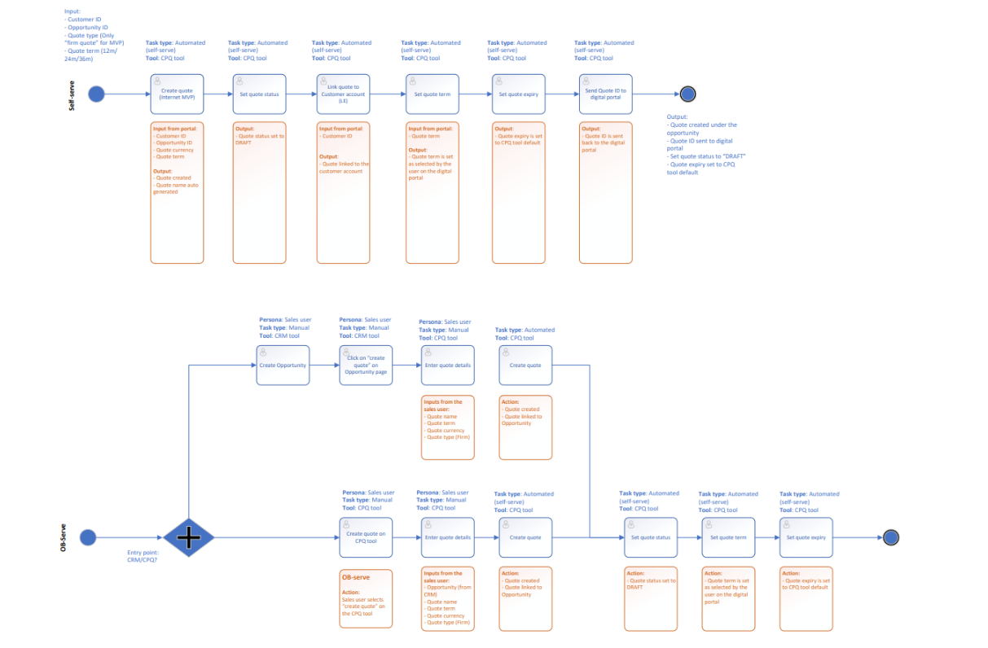
EPIC (L2)- Quote offer Creation (1/7)
L4- Quote offer initialization
Version 03/2025
Notes:
Process Diagrams

Slide 42
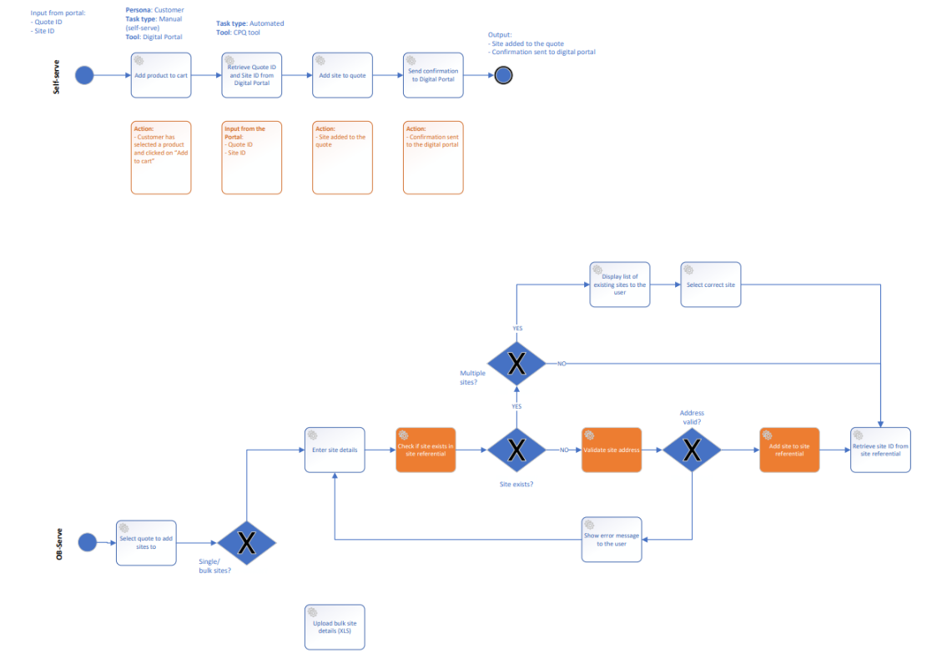
EPIC (L2)- Quote offer Creation (2/7)
L4- add sites to quote
Version 03/2025
Notes:
Process Diagrams

Slide 43
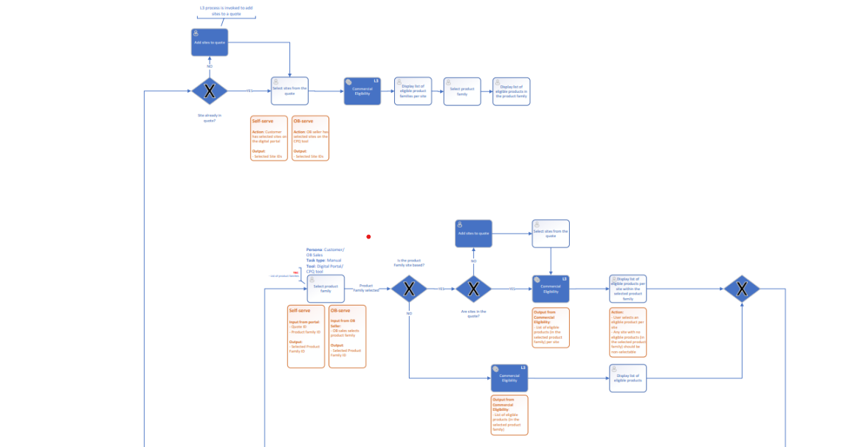
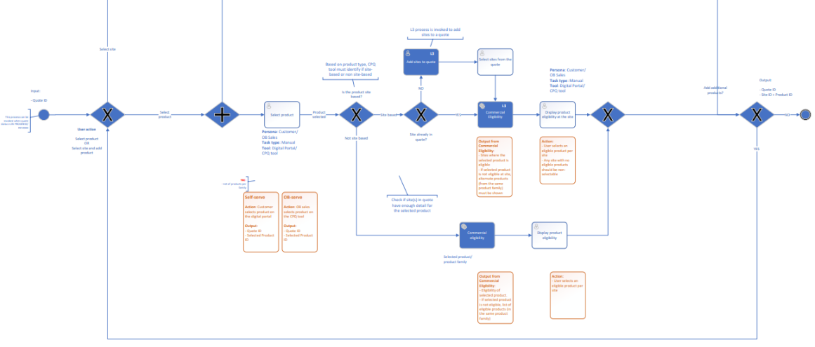
EPIC (L2)- Quote offer Creation (3/7)
L4- Retrieve eligible product
Version 03/2025
Notes:
Process Diagrams

Slide 44
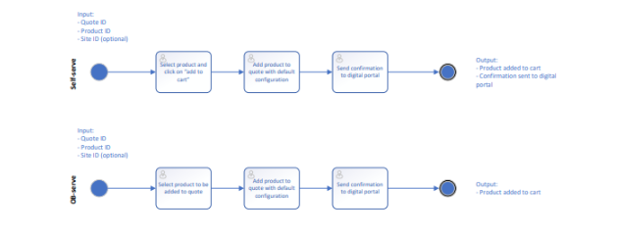
EPIC (L2)- Quote offer Creation (4/7)
L4- add product to quote
Version 03/2025
Notes:
Process Diagrams

Slide 45
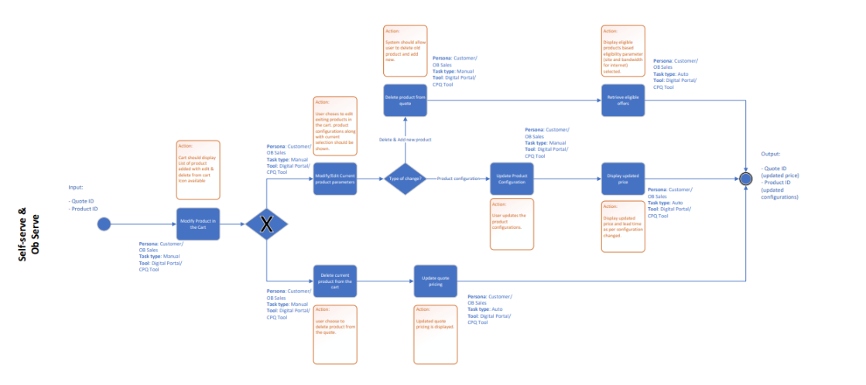
EPIC (L2)- Quote offer Creation (5/7)
L4- Modify, delete product in quote
Version 03/2025
Notes:
Process Diagrams

Slide 46
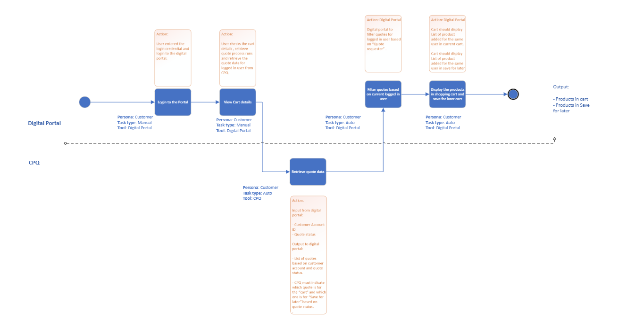
EPIC (L2)- Quote offer creation (6/7)
L4- Retrieve quotes
Version 03/2025
Notes:
Process Diagrams

Slide 47
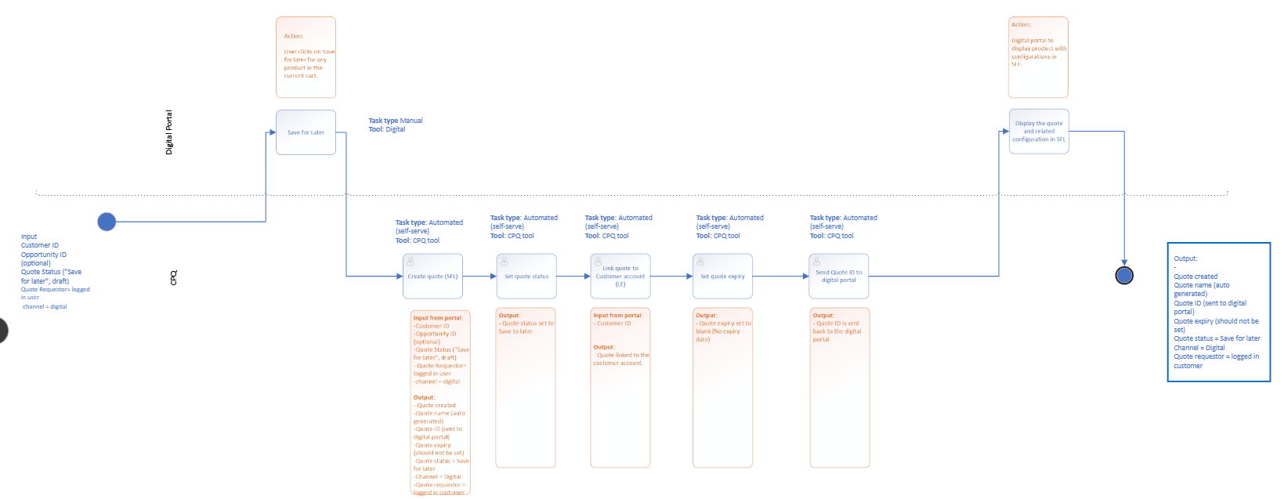
EPIC (L2)- Quote offer creation (7/7)
L4- save for later
Version 03/2025
Notes:
Process Diagrams

Slide 48
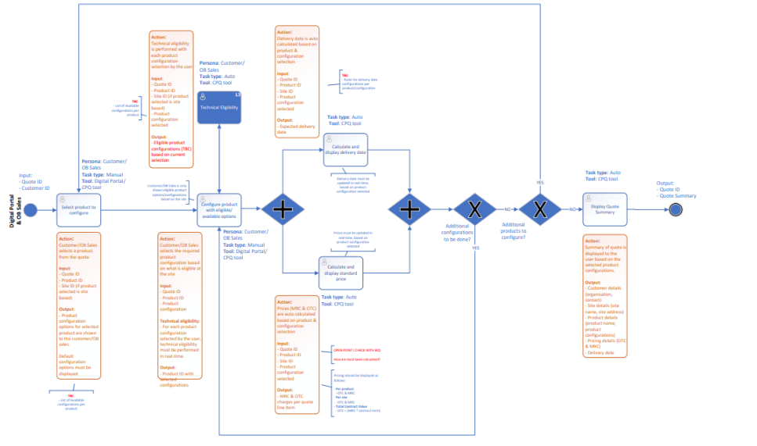
EPIC (L2)- Quote offer Pricing
L4- Configure, product & view pricing
Version 03/2025
Notes:
Process Diagrams

Slide 49
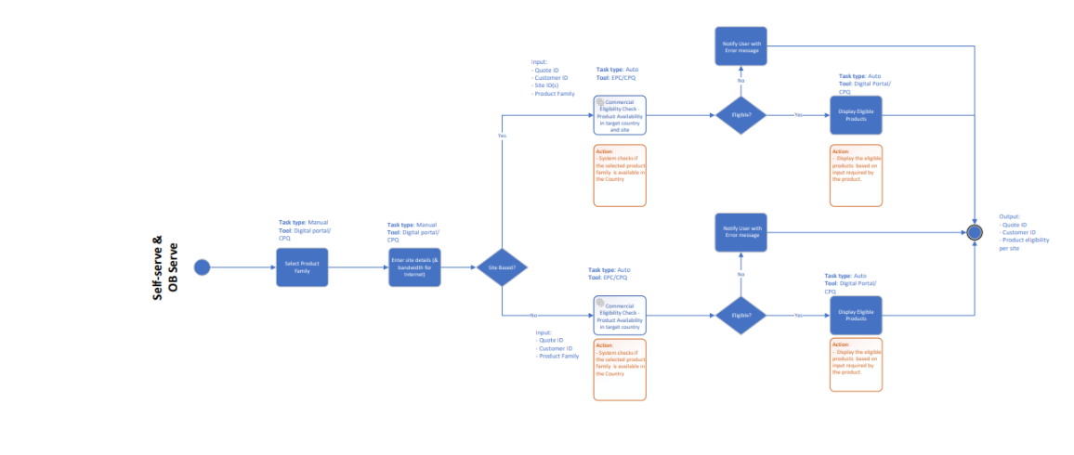
EPIC (L2)- Quote offer Eligibility (1/2)
L4- Commercial eligibility
Version 03/2025
Notes:
Process Diagrams

Slide 50
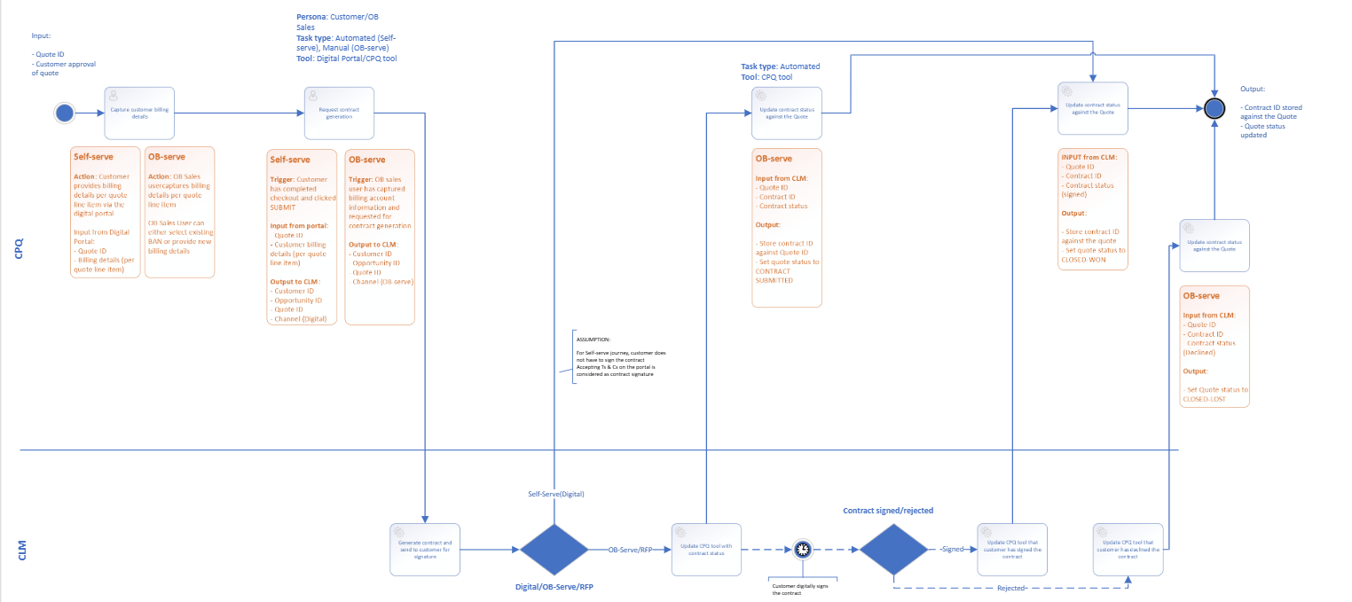
EPIC (L2)- Quote offer Customer Approval (1/3)
L4- Request for contract
Version 03/2025
Notes:
Process Diagrams

Slide 51
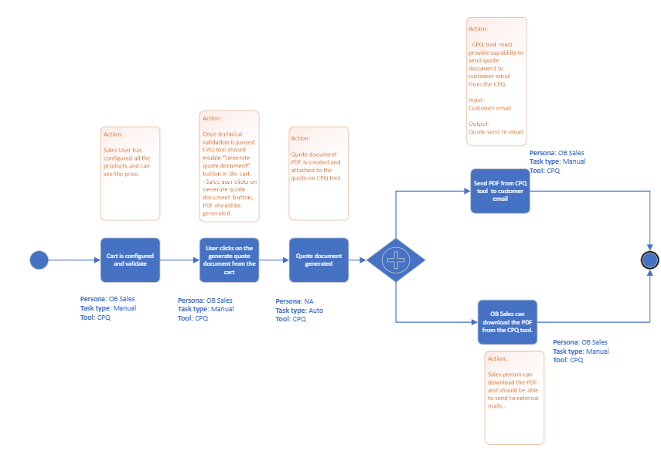
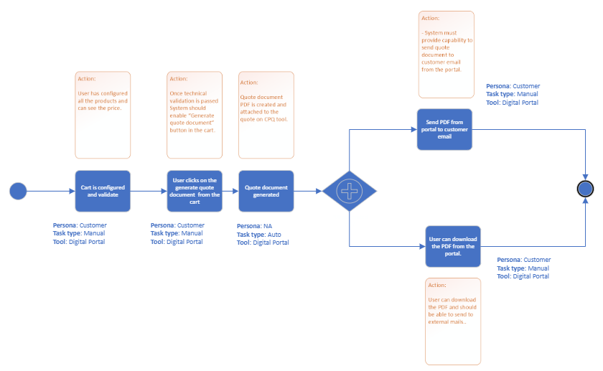
EPIC (L2)- Quote offer Customer Approval (2/3)
L4- generate quote document
Version 03/2025
Digital Portal
CPQ
Notes:
Process Diagrams

Slide 52
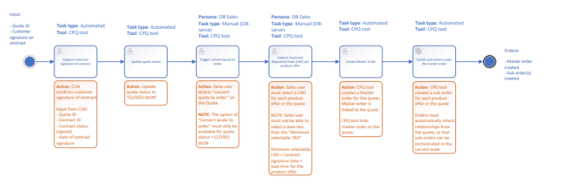
EPIC (L2)- Quote offer Customer Approval (3/3)
L4- Convert quote to oder
Version 03/2025
Notes:
Process Diagrams

Slide 53
QUOTE as an object
Quote Lifecycle
Quote Status description
Quote Template-fields description
CPQ Data Model
Quote Objects description

Slide 54

DRAFT
Quote Object Life-cycle
MVP path and MMP path – 2 approvals for Quote and Contract
Caption
Quote status in CPQ
MVP path
MMP path
(draft)
Is the quote approved internally ?
YES
PENDING APPROVAL
Internal
Validation
REFUSED internally
Recall Quote
NO
ABANDONED
NO
CONTRACT SUBMITTED
YES
Does OB wish to amend the quote?
Quote
Submission internally
APPROVED internally
PENDING APPROVAL
Is the quote valid ?
Has the customer approved the quote ?
Has the customer approved the contract, or would he like to make changes/refused it ?
REFUSED by customer
DRAFT
Quote
Population
IN PROGRESS
Quote
Verification
READY
Quote
Generation
SUBMITTED to customer
Customer
Validation
ACCEPTED by customer
Contract Generation
CONTRACT SUBMITTED
Customer
Validation
CLOSED WON
YES
YES
YES
Quote
Verification
NO
NO
NO
Eligibility check, validity check…
SAVED FOR LATER
REFUSED by customer
?
Is the quote to be retrieved ?
Recall Quote
Quote
Cancellation at any stage
YES
Recall Quote
MACD in quote
OR: retrieve saved for later quote
Is the quote to be amended ?
NO
CLOSED LOST
ABANDONNED
Notes:
Distinction à faire entre les statuts dans CRM et statut dans CPQ:
CRM: quote resquested, quote in progress, quote submitted, quote refused, quote accepted, quote completed
CPQ: quote draft, quote pending approval, quote revision, quote refused internally, quote approved internally, quote submitted to client, quote abandoned, quote accepted by client, quote refused by client, quote closed won, quote closed lost, reassigned, recalled

Slide 55
DRAFT
Quote Object Life-cycle
MVP path and MMP path – 1 single approval for Quote & Contract
Caption
Quote status in CPQ
MVP path
MMP path
(draft)
Is the quote approved internally ?
YES
PENDING APPROVAL
Internal
Validation
REFUSED internally
Recall Quote
NO
ABANDONED
NO
YES
Does OB wish to amend the quote?
Quote
Submission internally
APPROVED internally
PENDING APPROVAL
Is the quote valid ?
Has the customer approved quote & contract?
ACCEPTED by customer
DRAFT
Quote
Population
IN PROGRESS
Quote
Verification
READY
Quote
Generation
SUBMITTED to customer
Customer
Validation
CLOSED WON
YES
YES
Quote
Verification
NO
NO
Eligibility check, validity check…
SAVED FOR LATER
?
Is the quote to be retrieved ?
Recall Quote
Quote
Cancellation at any stage
YES
Recall Quote
MACD in quote
OR: retrieve saved for later quote
Is the quote & contrat to be amended ?
NO
CLOSED LOST
ABANDONNED
Notes:
Distinction à faire entre les statuts dans CRM et statut dans CPQ:
CRM: quote resquested, quote in progress, quote submitted, quote refused, quote accepted, quote completed
CPQ: quote draft, quote pending approval, quote revision, quote refused internally, quote approved internally, quote submitted to client, quote abandoned, quote accepted by client, quote refused by client, quote closed won, quote closed lost, reassigned, recalled

Slide 56
DRAFT
Quote Object Life-cycle
MVP path and MMP path (draft)
Caption
Quote status in CPQ
MVP path
Does OB wishes to provide a new version ?
MMP path
(draft)
Recall quote
ABANDONED
Quote version incremented
Quote archived
YES
NO
YES
REFUSED
internally
Does OB wishes to provide a new version ?
Recall Quote
Quote Cancelation
NO
Quote
Submission internally
PENDING APPROVAL
Internal Validation
YES
APPROVED
internally
NO
Contract refusal captured by CLM
CLOSED LOST
Is the quote approved ?
NO
Does the customer accept the quote ?
DRAFT
Quote
qualification
READY
Quote
Submission to client
SUBMITTED
to client
Client
Validation
Quote Approval captured by
Digital channels
OB-sales on CPQ
Quote creation triggered by :
CRM
Digital channels
OB-sales on CPQ
Quote line items are ready, meaning line items are ready for submission (products, config, eligibility) and mandatory quote details provided
Quote submission through CPQ by OB sales
For online journey, the digital layer will manage the transactions to transition from submitted to accepted to closed won
YES
CLOSED WON
Quote Cancelation at any stage
ACCEPTED
by client
Request for contract
Contract Signature captured by CLM
ABANDONED
Quote expiration captured by CPQ
Notes:
Distinction à faire entre les statuts dans CRM et statut dans CPQ:
CRM: quote resquested, quote in progress, quote submitted, quote refused, quote accepted, quote completed
CPQ: quote draft, quote pending approval, quote revision, quote refused internally, quote approved internally, quote submitted to client, quote abandoned, quote accepted by client, quote refused by client, quote closed won, quote closed lost, reassigned, recalled

Slide 57
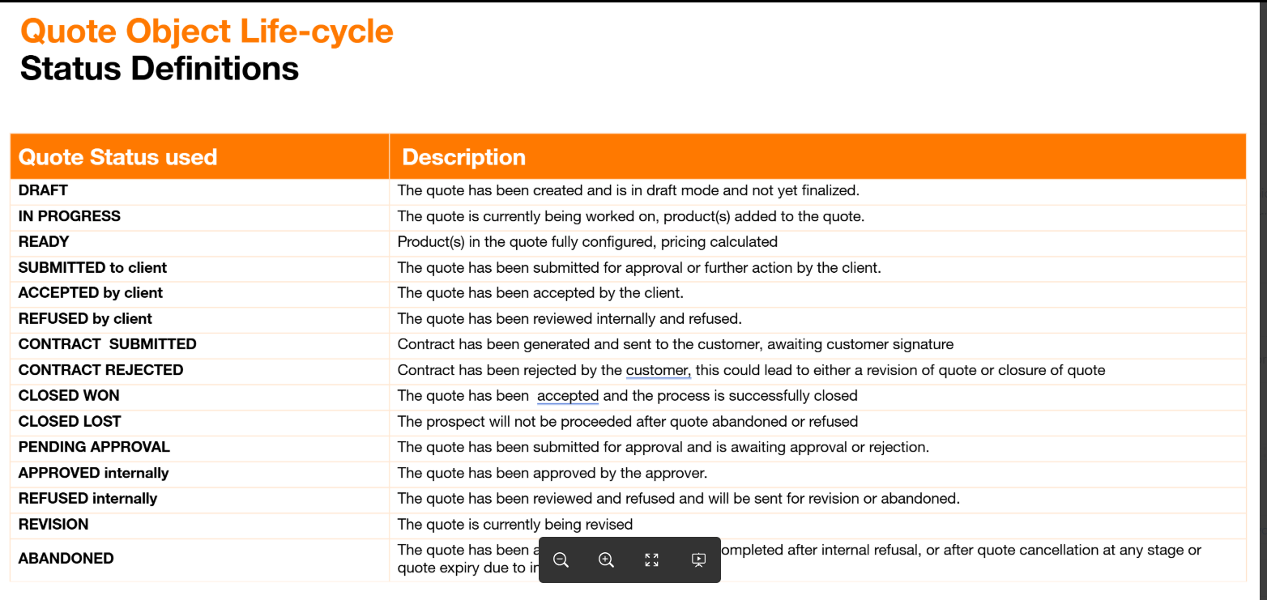
Quote Object Life-cycle
Status Definitions
Quote Status used | Description
DRAFT | The quote creation has been triggered – by CRM, digital channel, OB sales in CPQ- and is in draft mode, ready to be populated.
IN PROGRESS | The quote is being populated by the customer or the sales agent. Products & services are added and configured.
READY | Quote line items are ready, meaning line items are ready for submission (products, config, eligibility) and mandatory quote details provided The quote is finalized and ready to be generated/send for internal approval.
SUBMITTED to client | The quote has been submitted for approval or further action by the client.
ACCEPTED by client | The quote has been accepted by the client and. Contract generation is triggered.
REFUSED by client | The quote has been reviewed internally and refused.
CLOSED WON | The quote has been accepted and the process is successfully closed. The quote is sent for order fullfilment.
CLOSED LOST | The prospect will not be proceeded after quote abandoned or refused. No amendment will be carried out.
PENDING APPROVAL | The quote has been submitted for approval and is awaiting approval or rejection from OB’s approvers according to OB strategy, gross margin, P&L.
APPROVED internally | The quote has been approved by the approver.
REFUSED internally | The quote has been reviewed and refused and will be sent for revision or abandoned.
SAVED FOR LATER (digital only ?) | When the customer logs out or wants to carry on his quotation journey later, the quote is saved for later. The quote could be retrieved from the digital portal to be amended or to be closed.
ABANDONED | The quote has been abandoned and will not be completed after internal refusal, or after quote cancellation at any stage.

Slide 58
DRAFT
Quote Permissions
Quote-level actions permitted based on the "quote state"
State | Add product | Add site | Configure & view pricing | Generate quote document | Request for contract | Convert to order
DRAFT | YES | YES | NO | NO | NO | NO
READY | YES | YES | YES | YES | NO | NO
SUBMITTED TO CLIENT | YES | YES | YES | YES | NO | NO
ACCEPTED BY CLIENT | YES | YES | YES | YES | YES | NO
CLOSED LOST | NO | NO | NO | NO | NO | NO
CLOSED WON | NO | NO | NO | NO | NO | YES
ABANDONED | NO | NO | NO | NO | NO | NO
SAVED FOR LATER | YES | YES | YES | YES | NO | NO

Slide 59
Quote Object Model
DRAFT
Customer Contacts
Site Referential
Account
Account ID
Opportunity
Opportunity ID
Customer Referential
1
1,n
Quote Group: within a multi-sites quote, a quote group can organize a colection of sites that can be quoted with the same product/ services configured.
Quote Member( =site): a location where customers may add product or services from OB or partner.
Project Quote: A project quote is a quote used to capture customers request for complex deals (numerous sites, multiples years) and establish the basis of a contract. For projects multiple firm quotes need to be raised reflecting segments of the project quote and an aggregate of service contracts should be signed for.
Firm Quote: used for or simple cases e.g. single service, single site. A firm quote can be decomposed into commercial order(s) ? for fulfillment upon service contract approval.
1
MSA contract
MSA contract ID
1
Project
Project ID
Quote linked to
0,1
Project/ Firm Quote
Firm Quote (& Service Contract)
1,n
Quote
Quote ID
Commercial Order
Order ID
1,n
1
1
1,n
Commercial order regrouping site related products
Service contract
Contract ID
1
1
TBC on service contract per product /site.
Is there an overarching contract at quote level ? .
0,1
0,n
Quote Site
(Quote Member)
1,n
Quote Group
Customer Pricebook
Price override (Discount)
0,n
1
1
1,n
Product Offering Price
1
Quote Line Item
Quote line Item ID
Commercial Order Line Item
1
1,n
1
Promotion
(EPC)
0,n
1
Cost override ?(bespoke process including cost attributes)
1
Commercial Offer
cost
Cost override ?
Quote Line Product
(bundle or simple)
Solution ?
0,1
0,n
Legend
Third party cost
Parc
Catalog
Contrat
CRM
Project
Order
Quote
Notes:
Curerntco : 50% of RFP answer is a cost override : there is a process where sales ask for a specific cost for a bespoke product => to be handled through cost override or cost definition or product variation?

Slide 60
CPQ Data Model
Quote Objects Definition
Object | Description | Related objects
Quote | A quote is an object and a document that captures customers requests based on standard and/or negotiated terms and specifies the price for a set of product & services. A quote is created by a sales or pre-sales representative or by a customer on a self-serve journey or by a partner. A quote is broken down into quote line items. Each quote line item allowing to aggregate the offer at a node level (the node can represent a site or a product level). A quote covers multiple-sites, multiple-products, and can capture multiple billing entities. A quote can be a project quote or a firm quote. A quote can have several versions. In the case of a self-serve journey, the quote mirrors the cart managed by the customer on the digital channel. It can be created by the customer and then be handed-over to a sales/pre-sales representative (and then sent back to a customer). At different stage of its life-cycle, a quote can include (see exhaustive list of info in the quote data dictionary): The primary sales representative associated with the quote The customer associated with the quote. It could include information related to customer identification (account name, ..), customer contact information (email, number, delivery address..), and billing information. The currency is for the quotation The products & services selected and configured to serve customer needs The quantity of each product requested. The customer sites details for which the products & services are selected The price conditions associated to each products & services (standard price and negotiated if any) conditions that may have been negotiated. The costs and associated margins for Orange Business The contract terms of each product The internal approval workflow and customer approval workflow Contract artefact (t&cs, clause) – to be confirmed with CLM A quote can be sent to customer as a document. A quote is linked to an opportunity. Multiple quotes can be linked to the same opportunity | Opportunity [1] * Project Quote MSA [1] Service Contract [N] Site [N] Line Item [N] * Commercial Orders [N] *
Project Quote | A project quote is a quote used to capture customers request for complex deals (numerous sites, multiples years) and establish the basis of a contract. It expresses the required resources needed and associated price. Upon approval, a project quote can be instantiated as an MSA contract. Upon approval, a project quote cannot directly be decomposed into orders for fulfillment. It will need to transition into 1 or multiple firm quote(s) to start fullfillment. Multiple project quotes can be linked to the same opportunity. | Project MSA contract
Firm quote | A firm quote is a quote used to capture customers request for nominal deals or for a batch of ready items from a project quote. A firm quote can be decomposed into commercial orders for fulfillment upon service contract approval. A firm quote can be associated to a project quote (not mandatory). Multiple firm quotes can be linked to the same opportunity. | Project quote Service Contract [1]

Slide 61
CPQ deep dives

Slide 62



Targeted MVP digital journey – « Save for later » option
Cart created
I select an offer, and I add it to cart
I can click on “Save for later”
I logout,
I login again and purse my buying journey
Digital Journey
User 1
User 1
Cart 1
Cart 1
Items saved for later
Cart 1
Items saved for later
CPQ share all quotes associated to the user
Which status ???
(Q1 & Q2)
Create Quote
(Q1)
Create Quote
(Q2)
Get Quotes
Q1
Q1
Q2
Q1
Q2
Processes
-
-
-
-
-
-
-
-
-
-
-
-
-
-
-
User 1
User 1
User 1
User 1
User 1
CPQ
Save for later
Save for later

Slide 63

MMP digital journey – « Save for later » option
Preferred option
OR
OR
Scenario #1
Mono-Cart (eg: MVP)
Scenario #2
Multi-Carts, mono-saved for later
Scenario #3
Multi-Carts, Multi-saved for later
MVP
User 1
User 1
User 1
Cart 1
Cart 1
Save for later 1
Digital Journey
Cart 1
Save for later
Cart 2
Save for later
Cart 2
Save for later 2
Cart 3
Cart 3
Save for later 3
-
-
-
-
-
-
User 1
User 1
User 1
Q1
Q4
Q1
Q6
Processes
Q1
Q2
SFL
-
-
-
-
-
-
-
-
-
User 1
User 1
User 1
-
-
-
-
-
-
User 1
User 1
User 1
Q2
Q2
Q5
SFL
CPQ
Save for later
User 1
User 1
-
-
-
-
Q3
-
-
Q3
User 1
Save for later
Q4
SFL

Slide 64
Targeted MVP digital journey – « Save for later » option
Cart created
I select an offer, and I add it to cart
I can click on “Save for later”
I logout,
I login again and purse my buying journey
Digital Journey
User 1
User 1
Cart 1
Cart 1
Items saved for later
Cart 1
Items saved for later
CPQ share all quotes associated to the user
Which status ???
(Q1 & Q2)
Create Quote
(Q1)
Create Quote
(Q2)
Get Quotes
Q1
Q1
Q2
Q1
Q2
Processes
-
-
-
-
-
-
-
-
-
-
-
-
-
-
-
User 1
User 1
User 1
User 1
User 1
CPQ
Save for later
Save for later

Slide 65
MMP requirements
Tomorrow MMP :
- an “order tracker” dashboard will allow the user to monitor the quotes requested/delivered
  Will require to collect all quotes/order/request (Snow) in all status
  Open points on expired quotes : do we show them ? need for user to access them ?
- The CPQ API to provide a filter mechanism allowing to get only the “necessary” quotes for a specific screen
Tbc if feasible for MVP – otherwise CPQ to send all quotes, and digital portal to filter
A user will have several carts/quotes and one save for later cart that is attached to the user (cart creator).
Get quotes retrieve created or received quote by the user logged on the digital portal
SFL quote should not expire
SFL is a new quote with product being duplicated from one to another (remove product from Q1 and add to Q2)
SFL rules : what de we do with all data ? Site, contact, etc..
Flag for SFL to be defined – pushed by portal (when creating the quote), and flagged by CPQ

Slide 66
Key Requirements for Site Data
Site addresses can be specified at three levels of granularity:
At each step of the journey (project quote, firm quote, commercial order), we shall capture the minimum required level of site details from the customer
The exact requirements related to address granularity at each step of the journey are product-driven (governed by the specification of the product in EPC by MKT) as the business will assume a risk on pricing & eligibility
  Eg: High-level address could be entered at project quote step and then refined into a full address at firm quote, and then enriched with the Below Adrdress detail at order management step.
Some specificities can be implemented at country level to match local requirement/regulation.
  For example, in France, Below address is required during quotation. Code IMB has to be included as part of the full address level.
Address granularity | Description | Example
High level | this is used only where the customer is providing limited information for example during an RFP response. | Country, City
Full address level | Full address or precise geolocation coordinates. | - Country, State, City, ZIP, Street number, Street name, - GPS coordinates.
Below Address level | this will be below the full address and allows the customer to specify the building (e.g. on a campus with a single address), the floor and the room. For France, this level of address is expected at firm quote level | Country, State, City, ZIP, Street number, Street name, Building, Floor, room, …

Slide 67
Proposition of new Site Address for internet products
MVP
Complex Project Flow
Quotation flow
Project Quote
Contract (MSA)
Project
Firm Quote & Service Contract
Commercial Order
Sales Rep enters the minimum level of address required by the product model
to get rough pricing
and commercial eligibility at country level
Site info is transferred
from project quote to firm quote
Sales Rep enrich site address to provide a firm quote and proceed to order.
Pricing and eligibility are refined
Sales rep journey
Site A | High Level Address
Street Number
Street Name
City | Munich
State
Zip
Country | Germany
Floor/ Building Number/Door
GPS Coordinates
Latitude
Longitude
Local Contact
Site A | Full Address Level
Street Number | 43
Street Name | Peter-Anders Strasse
City | Munich
State
Zip | 80234
Country | Germany
Floor/ Building Number/Door | Required in France
GPS Coordinates
GPS - Latitude | 48,15 N
GPS - Longitude | 11,48 E
Local Contact ?
Site A | Below Address | Below Address Level
Street Number | 43 | 43
Street Name | Andere Strasse | Andere Strasse
City | Munich | Munich
State
Zip | 80234 | 80234
Country | Germany | Germany
Floor/ Building Number/Door | Floor 11 | Floor 11
GPS Coordinates
GPS - Latitude
GPS - Longitude
Local Contact ? |  | M. Johnes +49xxx

Slide 68
CSG solution for CPQ

Slide 69
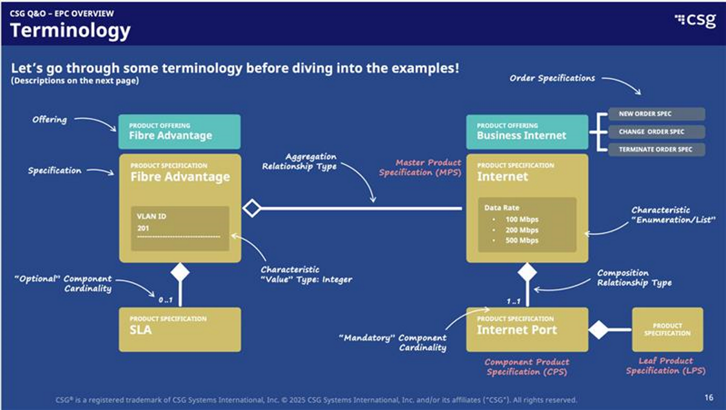

Slide 70
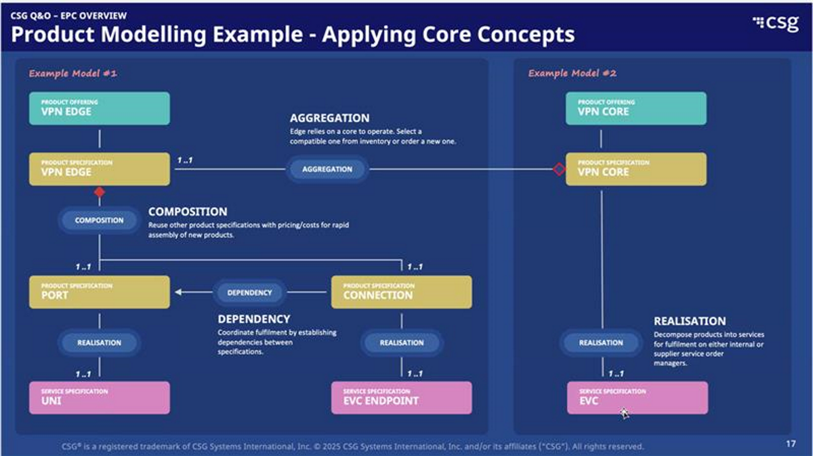

Slide 71
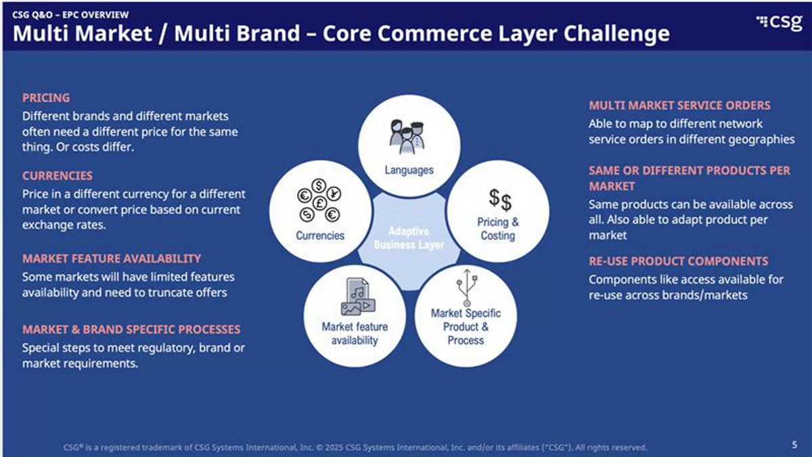

Slide 72
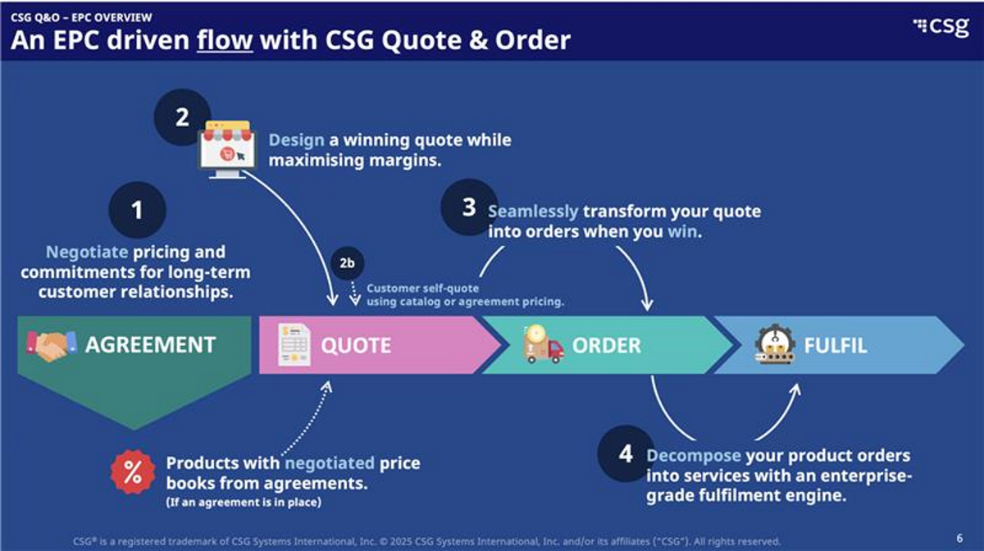

Slide 73
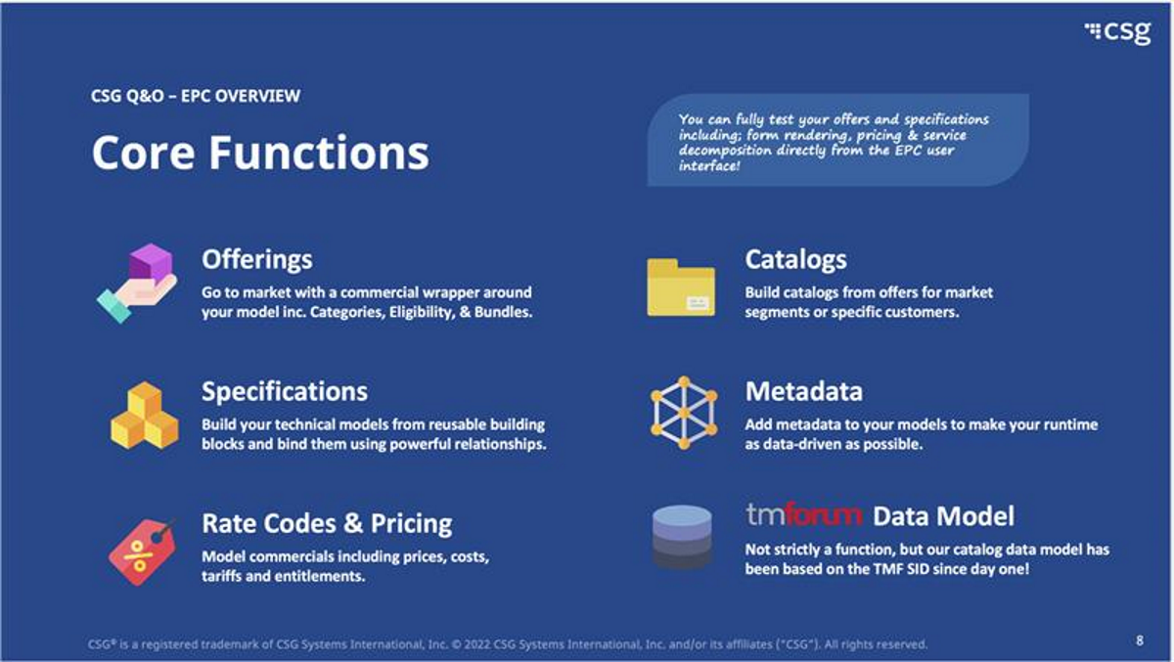

Slide 74
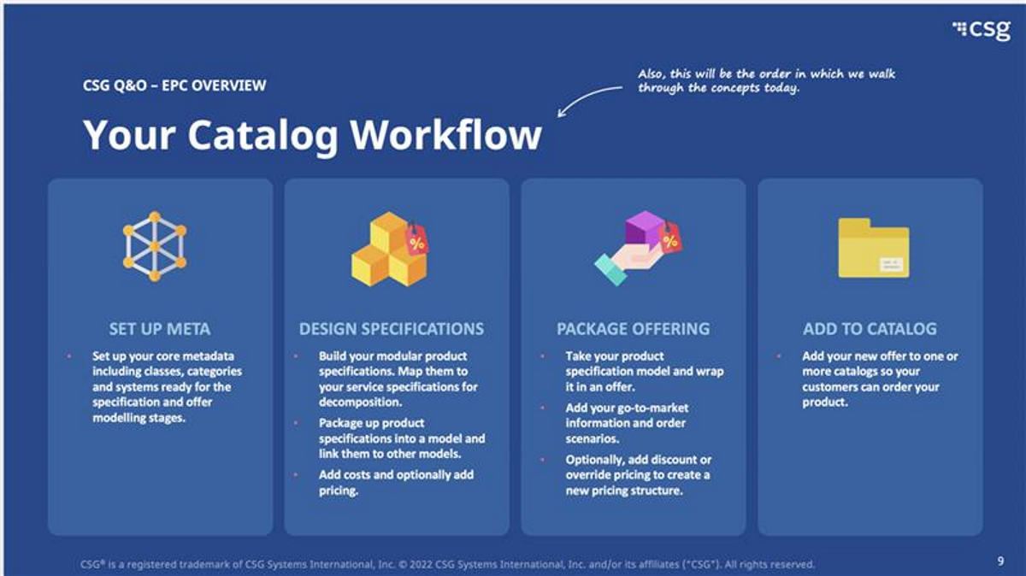

Slide 75
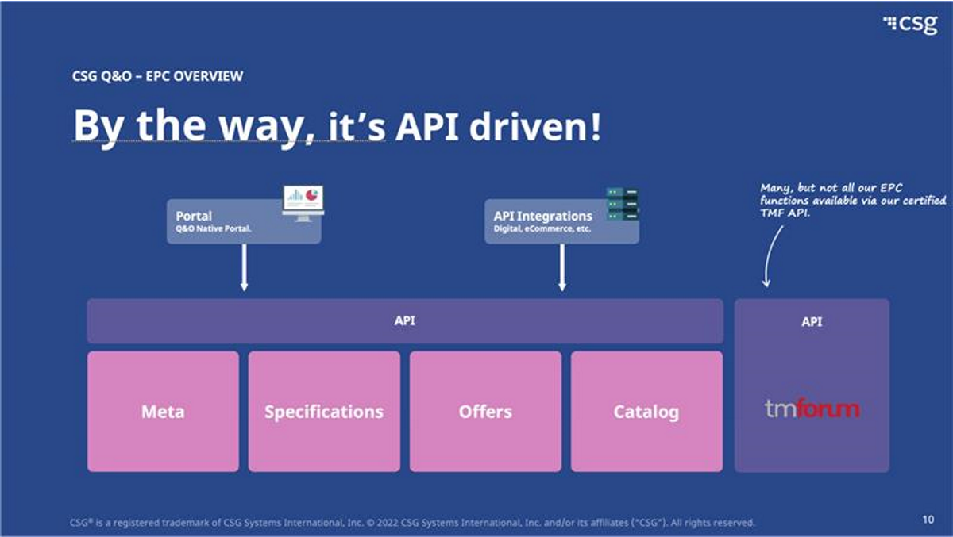

Slide 76
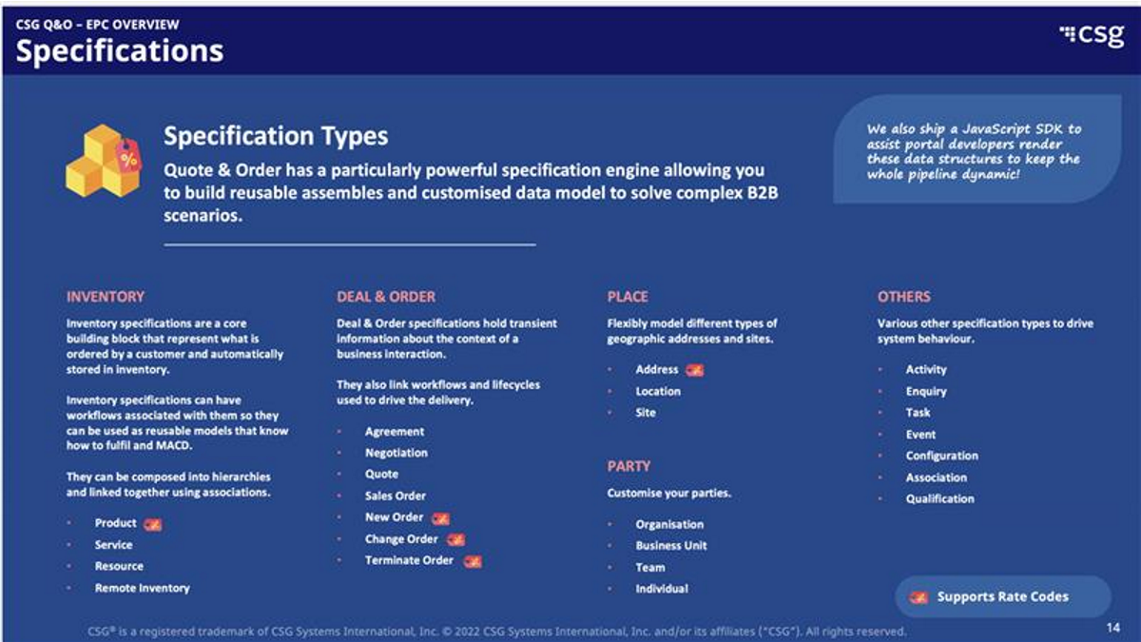

Slide 77
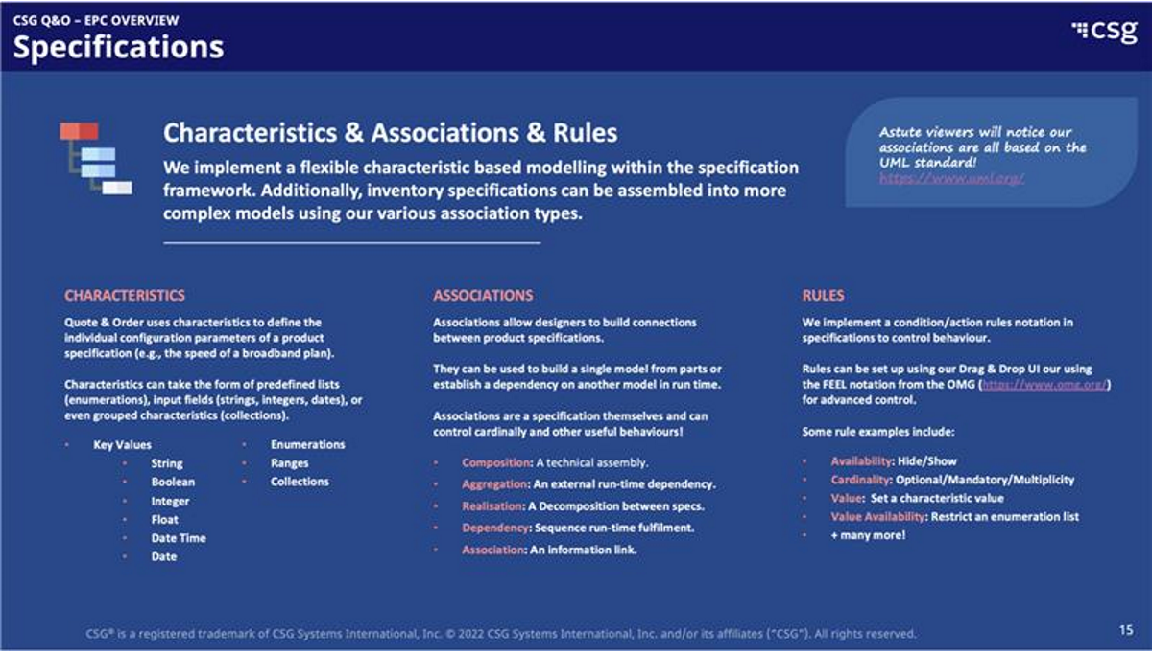

Slide 78
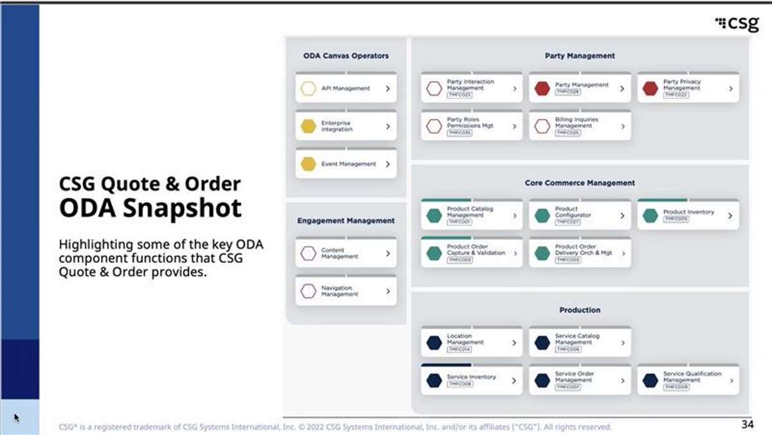

Slide 79
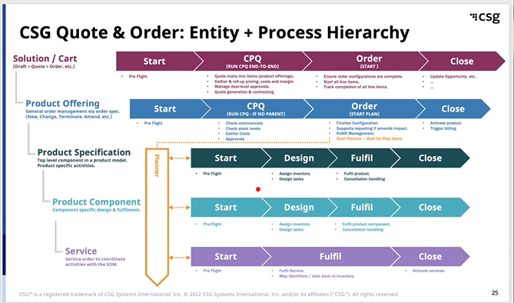

Slide 80
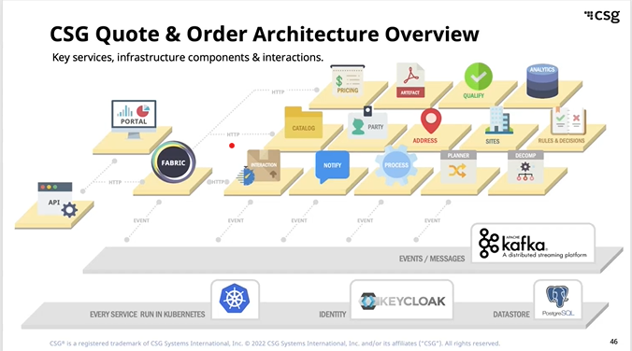

Slide 81
01
Quote offer initialization (from a Sales Order)
Notes:
Quote creation (which input, opportunity, template, clone quote)

Slide 82
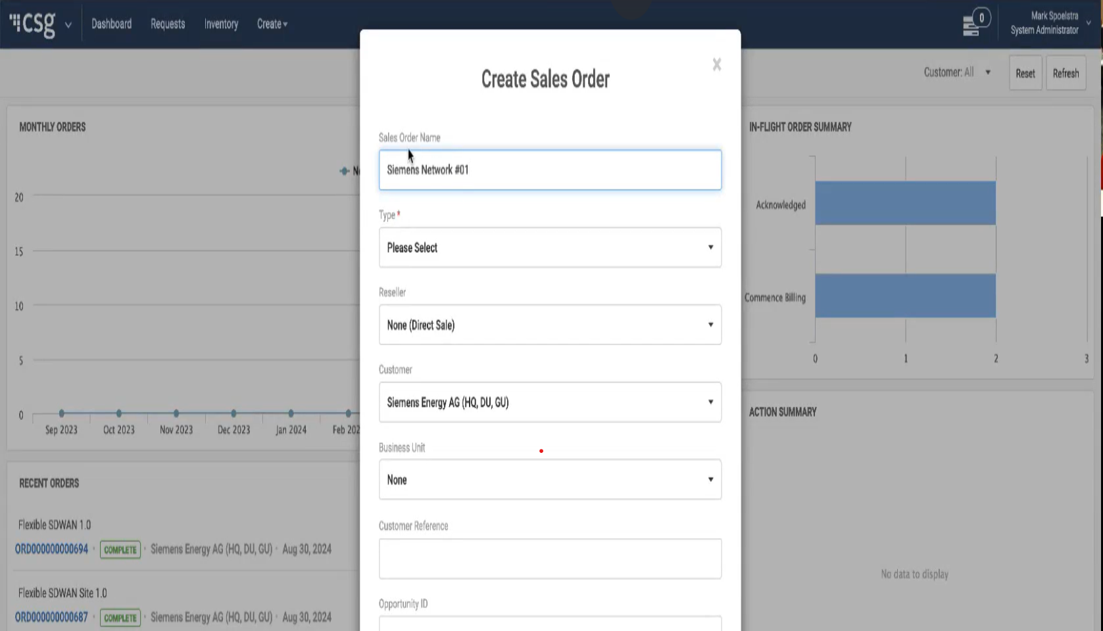
Step 1: create a Sales Order
The content that guides the user through the quote journey and the order journey.
Notes:
Type « of solution »
Opportunity id enable to navigate between Salesforce interface
OB POC Sprint Demo - Team Bravo-20240830_104254-Meeting Recording.mp4

Slide 83
02
Identify, Retrieve, Select Product
Notes:
Select product, product family, site based or not, add site to quote, commercial eligibility, serviceability for multiple sites

Slide 84
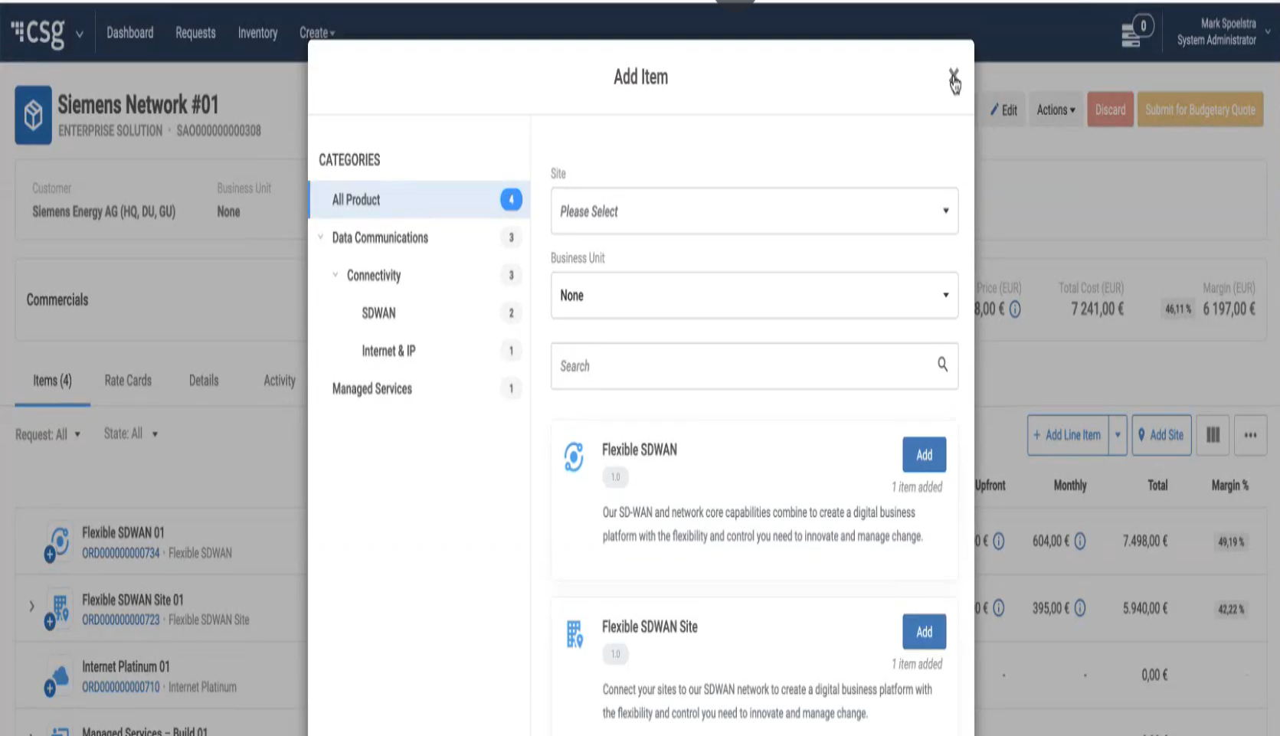
Step 2: Add line items
Notes:
OB POC Sprint Demo - Team Bravo-20240830_104254-Meeting Recording.mp4

Slide 85
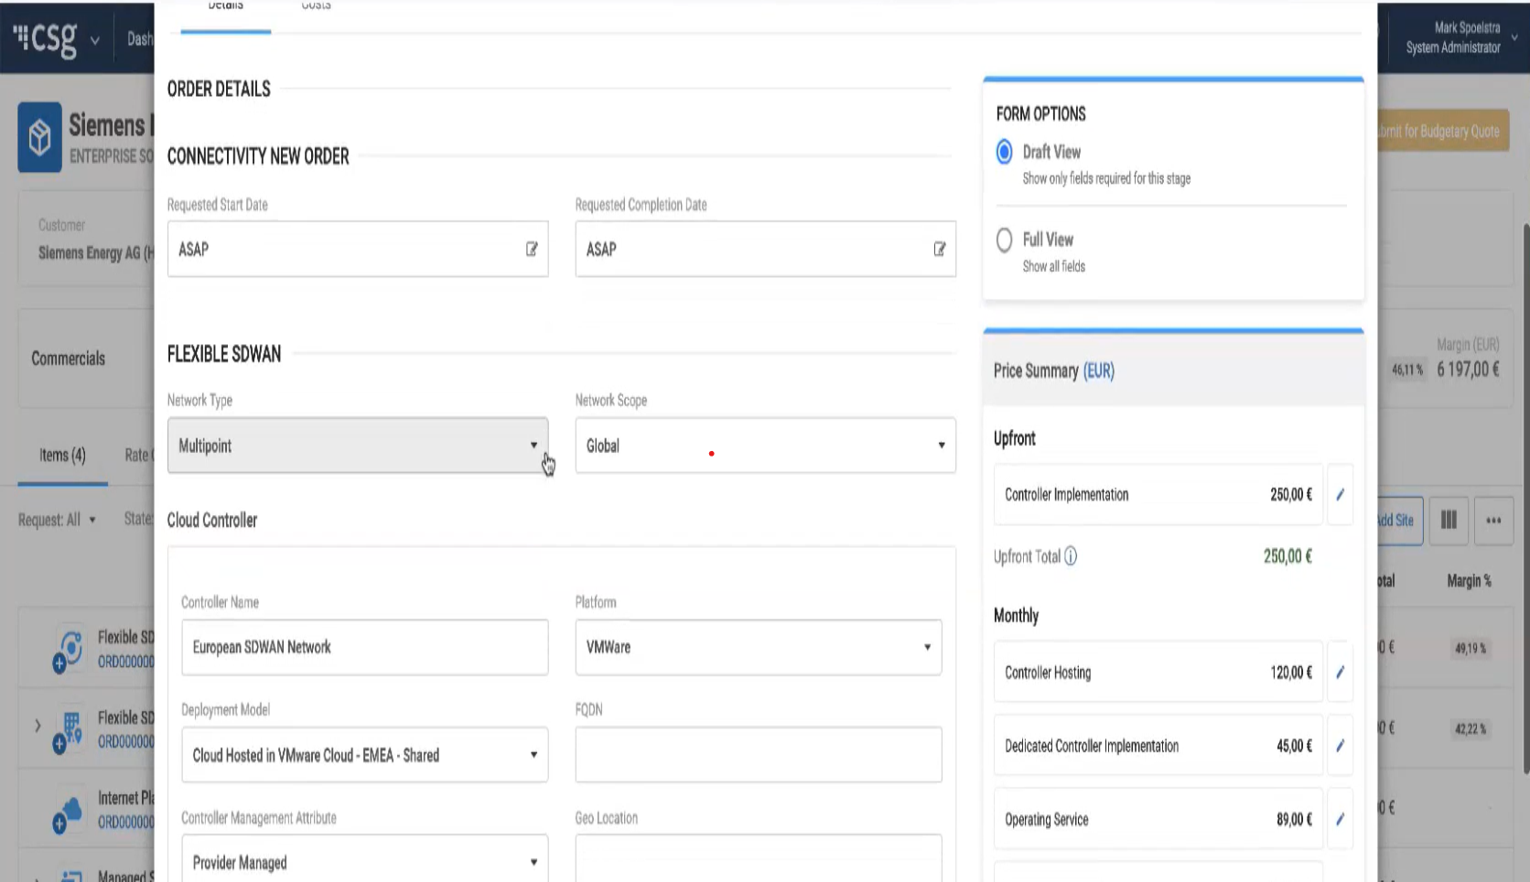
Budgetary Quote
Select a product. Have access to the minimum information- standard pricing.
Order Specification
Product Information
Notes:
OB POC Sprint Demo - Team Bravo-20240830_104254-Meeting Recording.mp4

Slide 86
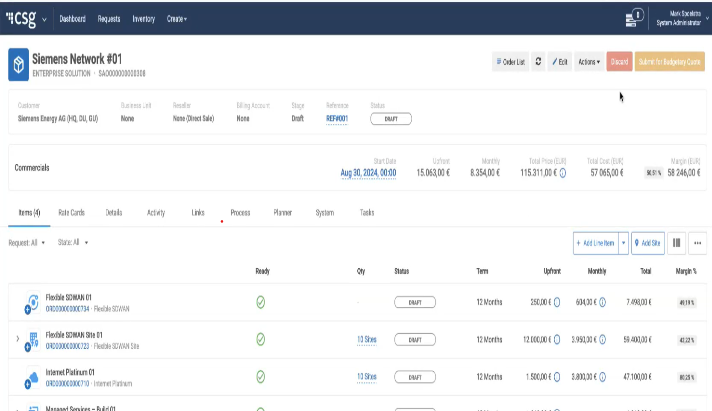
Budgetary Quote Draft
Notes:
OB POC Sprint Demo - Team Bravo-20240830_104254-Meeting Recording.mp4

Slide 87
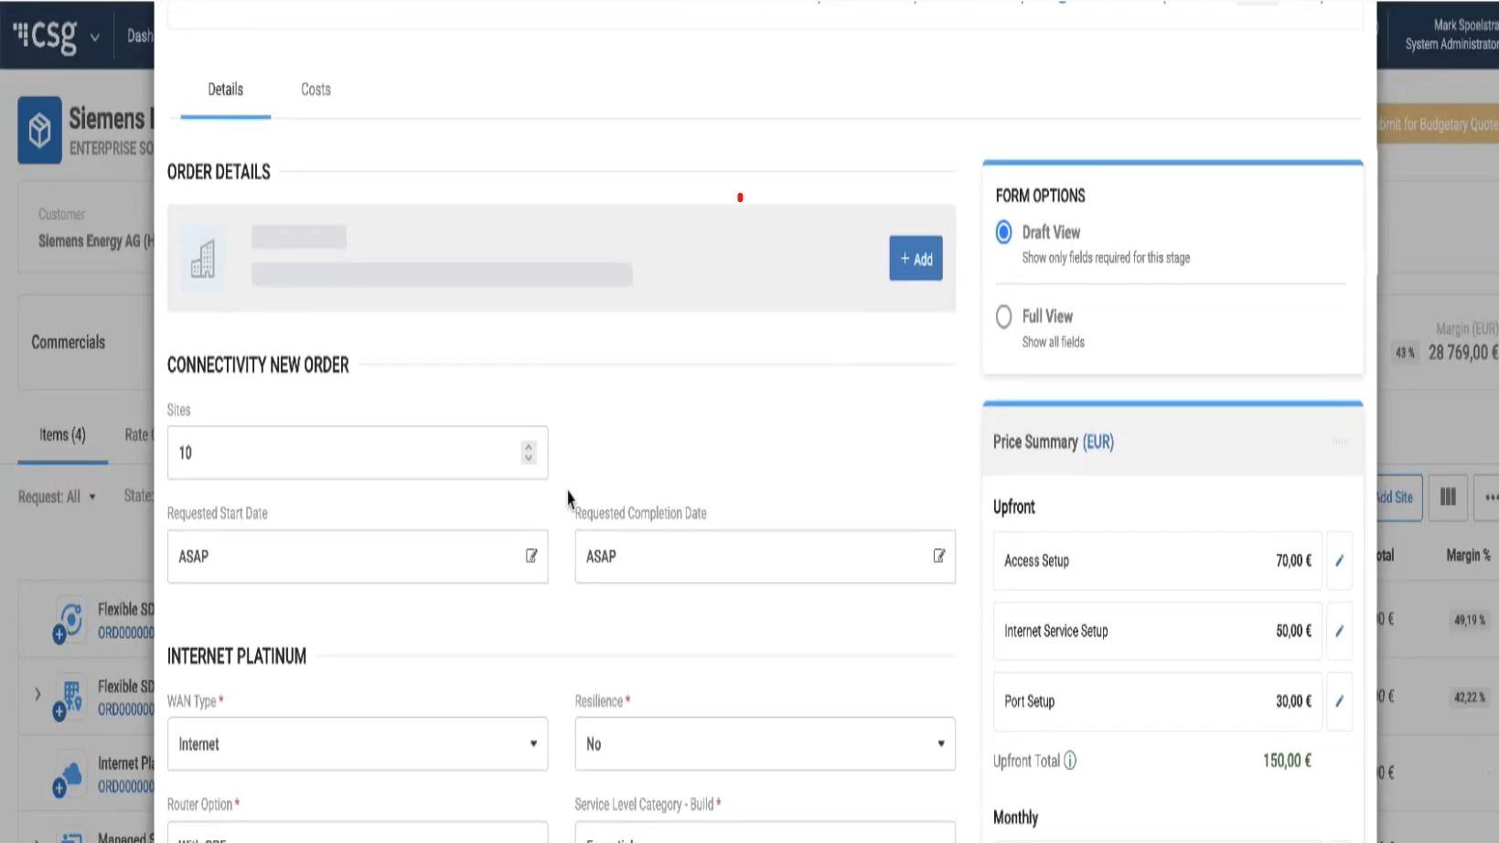
One product - several sites
Click on the product. Add the number of sites required.
Notes:
OB POC Sprint Demo - Team Bravo-20240830_104254-Meeting Recording.mp4

Slide 88
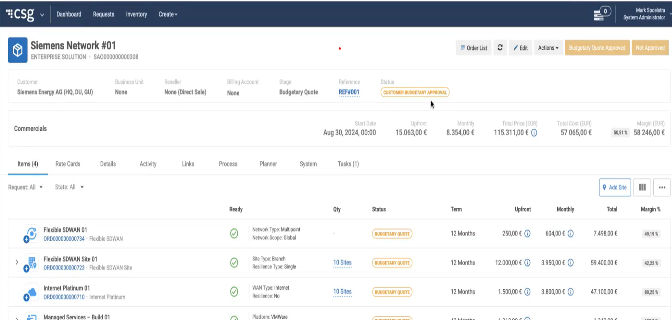
Budgetary Quote Overview before first approval
Notes:
OB POC Sprint Demo - Team Bravo-20240830_104254-Meeting Recording.mp4

Slide 89
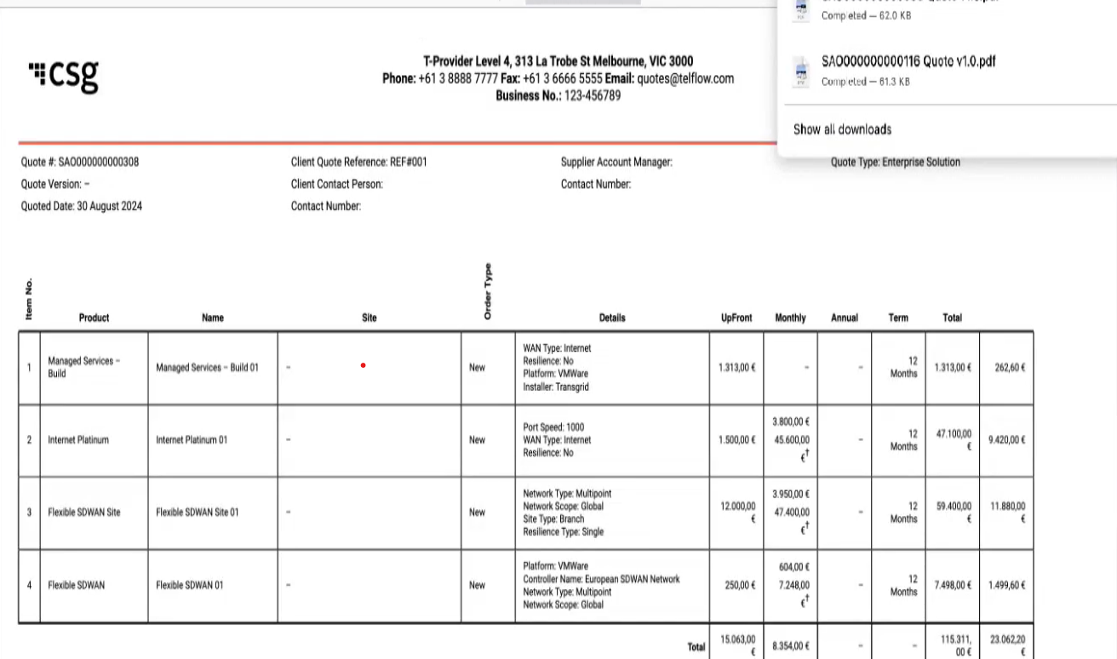
Quote Summary
Notes:
OB POC Sprint Demo - Team Bravo-20240830_104254-Meeting Recording.mp4

Slide 90
03
Quote offer initialization (from an Opportunity on Salesforce)

Slide 91
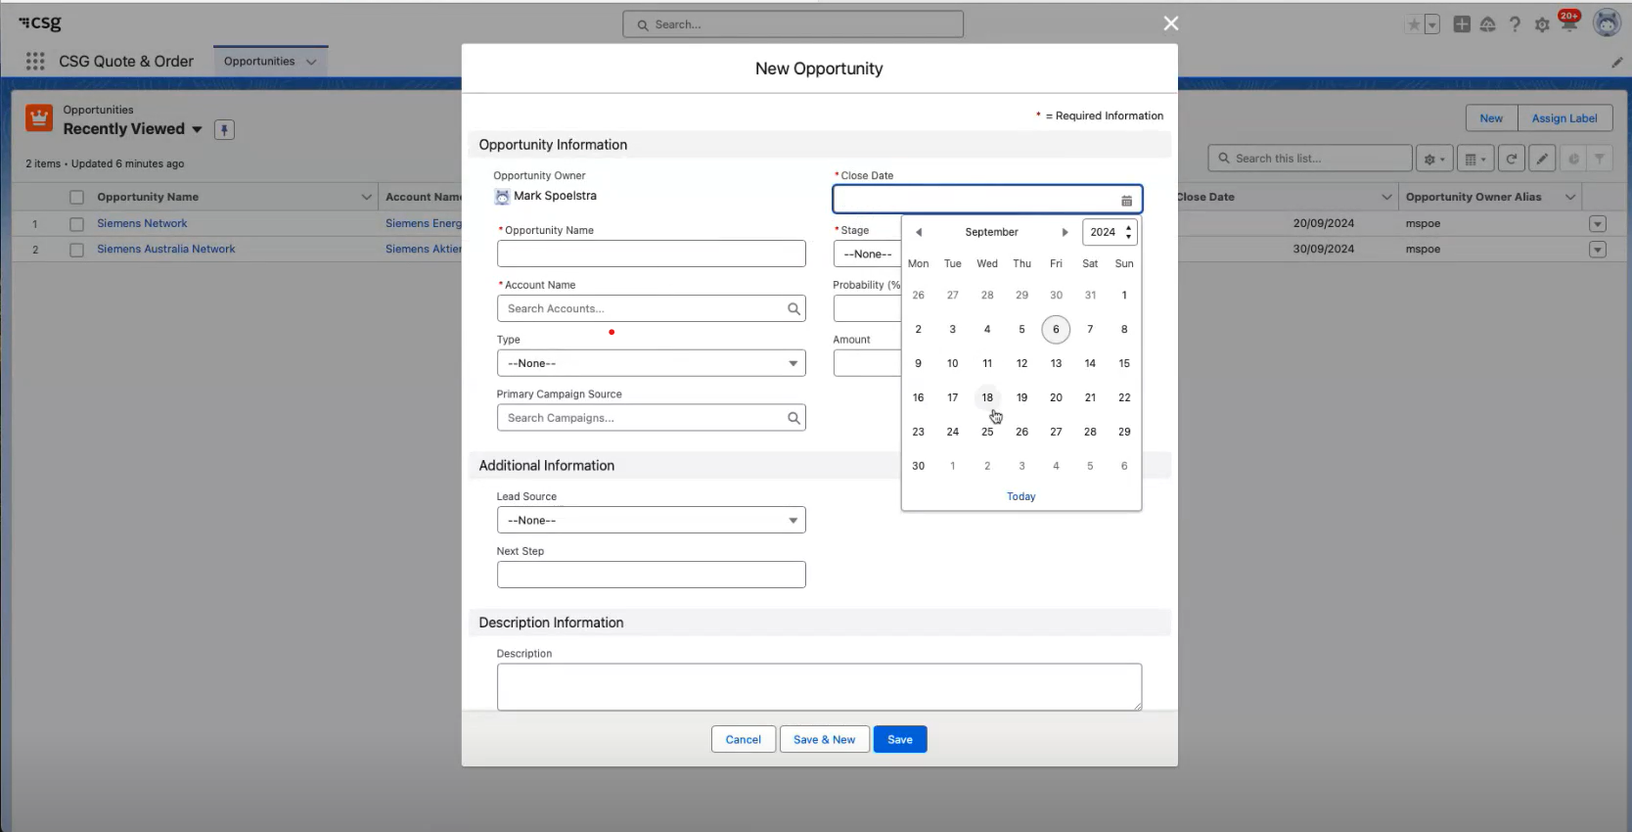
Opportunity creation
Notes:
OB POC Sprint Demo - Team Bravo-20240906_115947-Meeting Recording.mp4

Slide 92
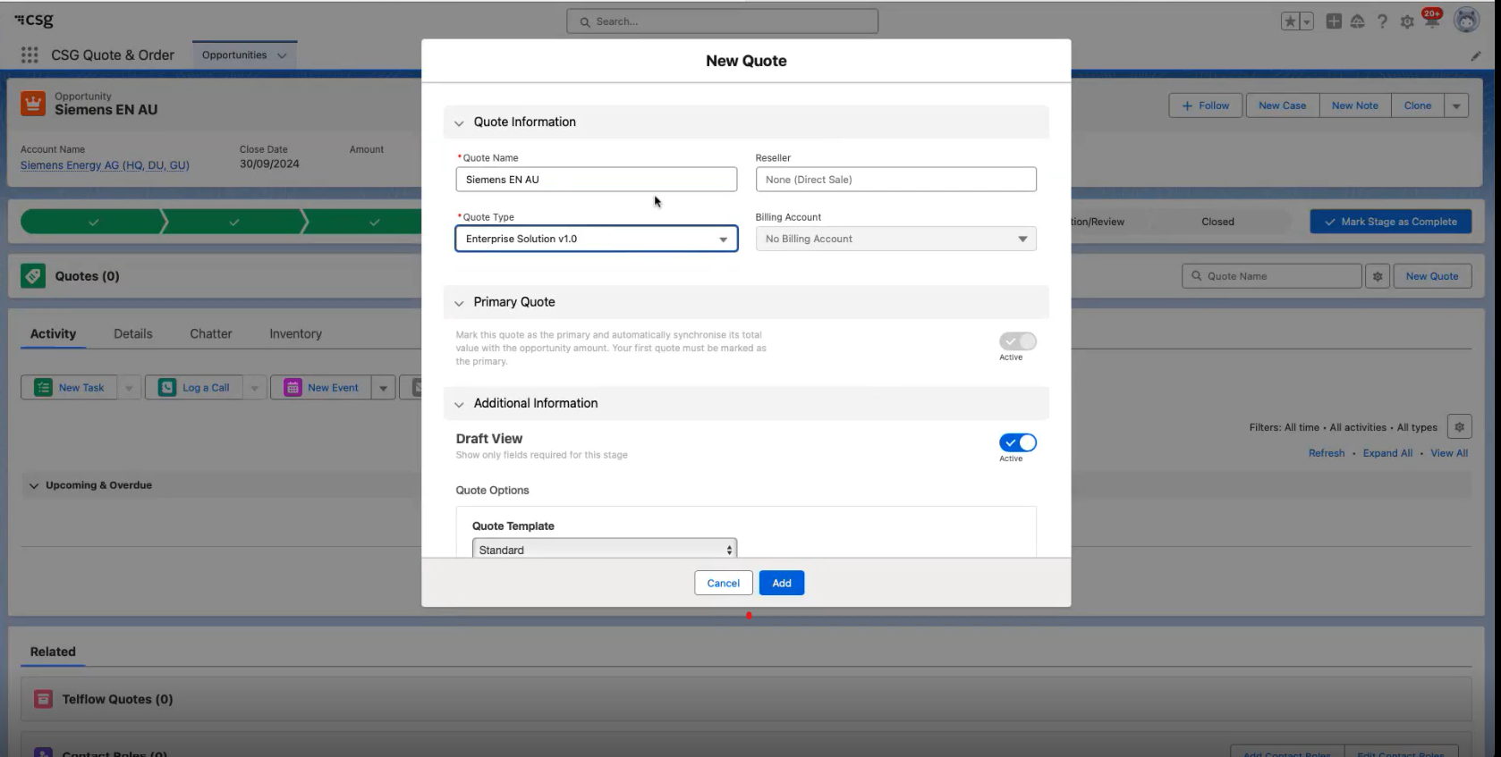
New quote creation

Slide 93
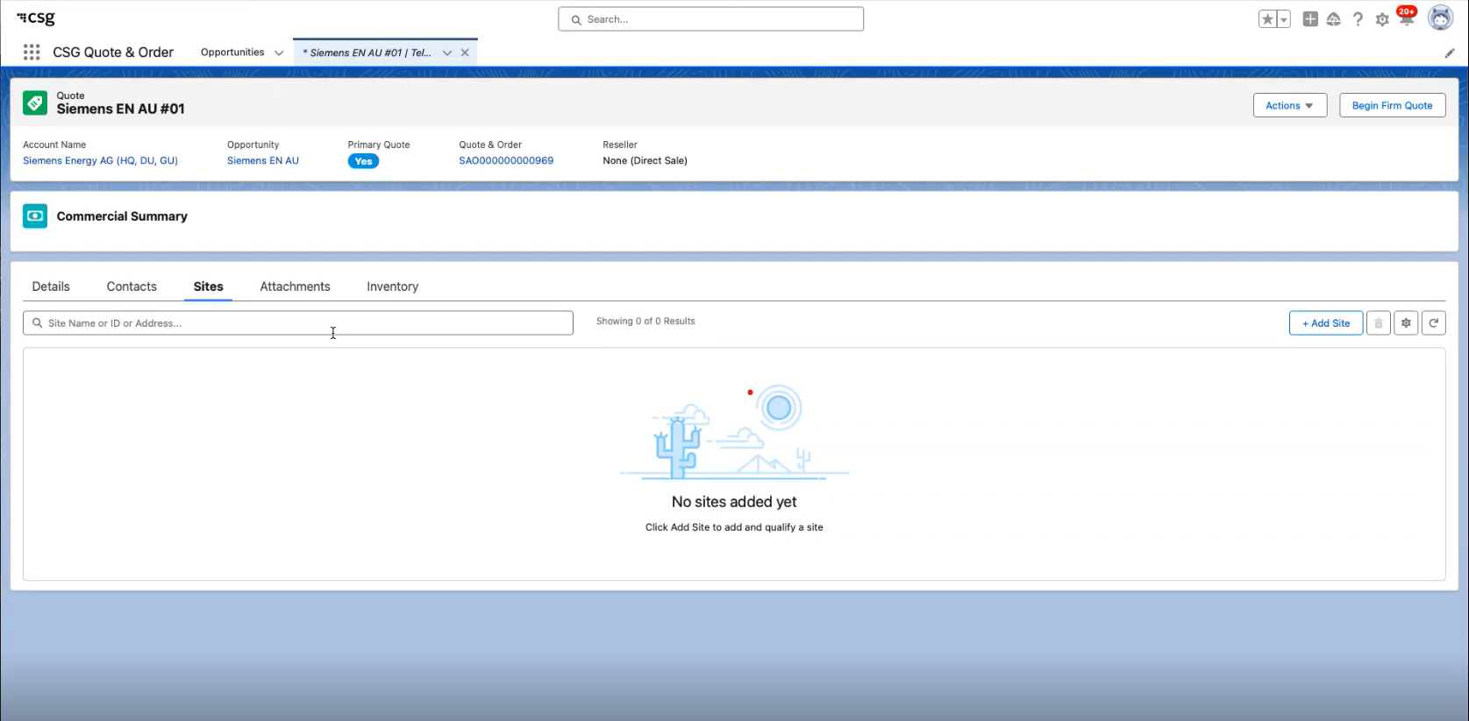
Add site to quote & Qualification

Slide 94
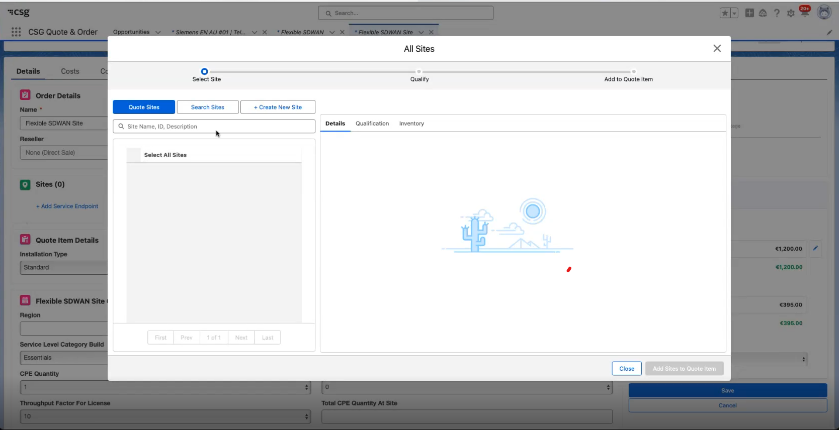
Add site to Product

Slide 95
Newco Vision for quotation

Slide 96
WIP
OB Newco Persona
Title | Alias | Description | Quote Actions
SALES | Account Manager
 | Business Developer
 | Pre-Sales
 | Business Manager/ Sales Specialist
 | Sales Advisor (Customer Contact Service)
Notes:
Légende:
Bleu=suggestion de functions à rajouter
Jaune=remarques

Slide 97
MVP quotation scope
For MVP, we need to define quotation processes that enable existing customers to place digital orders for Internet products and enable sales team push SD-wan orders for fulfillment
 | Scopless Internet Product | SDWAN Product
MVP | Quoting journey from a digital perspective (end customer / agent) OBI existing customer only No resilience concept Std pricing only => market based pricing / no country specific / no market segment / no customer base Digital journey : logged in user, in position to quote, already onboarded No managed / professional services 20 countries for MVP (if more required, P&M to provide price grid) Single currency only (euro ? TBC) Firm quote only Basic eligibility check – matrix based Per Access quote (no bulk site quote) Exit/Fail route: capture the request/requirement Standard Cisco CPE only / No Bring Your Own CPE No Cross product requirement No discounting (TBC Thursday morning during pricing discussion) Access Type: wired access types No upload & Download BW distribution Platinium: DIA (OB CPE) / Gold: DIAP (no CPE) / Silver: BIAP (no CPE) | Cisco and Velocloud are the selected vendors for the MVP Cisco – AWS controller VeloCloud hosted controller Geography for the MVP: 2 x France and 1 x Europe Existing customer not having SDWAN service CPE Support: 2 types for Cisco 2 types for VeloCloud No BYOL capability, licences are managed by OB No co-management scenario with the customer CPE installation: P2P OB installed M&O SM not in scope CPQ: Standard price book only Build / operate / transfer not in scope No digital portal Semi-automated fulfilment process New contract, no existing MSA in scope. Only service contract is in scope – treated as a new product with no previous pricing terms agreed with the customer. No budgetary quote, firm quote only
MVP scope
Customer : existing, international
Customer sites : new sites
Catalogue : standard products (no bespoke)
Quote scope : multi-sites, mono-product
Pricing : Standard prices (no discount, nor GM approval)
Currency : one currency (€)
Geographies : 20 countries
Eligibility
Source : Customer journey from “L2Q business design description’

Slide 98











MVP requirements for features
Reflection on technical/Business debt
Product Agnostic :
Scopeless :
Digital ready :
L2 - Quote offer creation
L2 - Quote offer pricing
L3 - Quote Offer Initialization
For MVP, all quotes created from CPQ (no CRM in MVP). For MMP, OBI/DEF quotes to be created from CRM. OBF requires both.
L3 - Quote state model
CTIO requirement for MVP.
L3 - Add sites to quote
Current level of data captured for site was built on Internet Depth of data will be product dependent extended post MVP for adding existing sites to quote Auto-completion
L3 - Configure product and view pricing
L3 - Retrieve eligible product
L3 - Add product to quote
L3 - Modify/Delete product to quote
L2 - Quote offer eligibility
L3 - Commercial Eligibility
Current rules are Internet dependent
L2 - Quote offer customer approval
L2 - Quote order capture
Defined in Iteration 3
Defined in Iteration 3
L3 - Capture customer approval of quote
For MVP, sales agent will capture manually customer approval. For MMP, customer approval capture should be automatic.
L3 - Request for contract
L3 - Convert Quote to order

Slide 99
MVP requirements for features
Reflection on technical/Business debt
Product Agnostic :
Scopeless :
Digital ready :
Quote offer creation
Quote offer pricing
Quote Offer Initialization
For MVP, all quotes created from CPQ (no CRM in MVP). For MMP, OBI/DEF quotes to be created from CRM. OBF requires both.
Quote state model
CTIO requirement for MVP.
Add sites to quote
Current level of data captured for site was built on Internet Depth of data will be product dependent extended post MVP for adding existing sites to quote Auto-completion
Configure product and view pricing
Retrieve eligible product
Add product to quote
Modify/Delete product to quote
Quote offer eligibility
Commercial Eligibility
Current rules are Internet dependent
Quote offer customer approval
Quote order capture
Defined in Iteration 3
Defined in Iteration 3
Capture customer approval of quote
For MVP, sales agent will capture manually customer approval. For MMP, customer approval capture should be automatic.
Request for contract
Convert Quote to order

Slide 100

L4- Quote Offer Initialization
Input:
Customer ID
Opportunity ID
Quote type (only
«firm quote » for MVP)
Quote term (12/24/36 months)
Task type: Automated (self-serve)
Tool: CPQ tool
Task type: Automated (self-serve)
Tool: CPQ tool
Task type: Automated (self-serve)
Tool: CPQ tool
Task type: Automated (self-serve)
Tool: CPQ tool
Task type: Automated (self-serve)
Tool: CPQ tool
Task type: Automated (self-serve)
Tool: CPQ tool
Create Quote (Internet MVP)
Set Quote Status
Link Quote to Customer Account (LE)
Set Quote Term
Set Quote Expiry
Send Quote ID to digital portal
Input from portal:
Customer ID
Opportunity ID
Quote currency
Quote term
Output:
Quote created
Quote name auto-generated
Output:
Quote status set to DRAFT
Input from portal:
Customer ID
Output:
Quote linked to the customer account
Input from portal:
Quote term
Output:
Quote term is set as selected by the user on the digital portal
Output:
Quote expiry is set to CPQ tool default
Output:
Quote ID is sent to the digital portal
Ouput:
Quote created under the opportunity
Quote ID sent to digital portal
Set qutoe status to « DRAFT »
Quote expiry set to CPQ tool default
Self-serve
Persona: Sales user
Task type: manual
Tool: CRM tool
Persona: Sales user
Task type: manual
Tool: CRM tool
Persona: Sales user
Task type: manual
Tool: CPQ tool
Task type: automated
Tool: CRM tool
Create Opportunity
Click on “Create quote” on Opportunity page
Enter quote details
Create Quote
Input from the sales user:
Quote name
Quote term
Quote currency
Quote Type (Firm)
Action:
Quote created
Quote linked to Opportunity
Persona: Sales user
Task type: manual
Tool: CPQ tool
Persona: Sales user
Task type: manual
Tool: CPQ tool
Task type: Automated (self-serve)
Tool: CPQ tool
Task type: Automated (self-serve)
Tool: CPQ tool
Task type: Automated (self-serve)
Tool: CPQ tool
Task type: Automated (self-serve)
Tool: CPQ tool
Self-serve
X
Create Quote on CPQ tool
Enter Quote Details
Create Quote
Set Quote Status
Set Quote Term
Set Quote Expiry
Action:
Sales user selects “create quote” on the CPQ tool
Input from the sales user:
Opportunity (from CRM)
Quote name
Quote term
Quote currency
Quote Type (Firm)
Action:
Quote created
Quote linked to Opportunity
Action:
Quote status set to DRAFT
Action:
- Quote term is set as selected by the user on the digital portal
Action:
- Quote expiry is set to CPQ tool default.

